Slide 1

Introduction to Operating Systems CS/COE 1550
Fall 2021
Sherif Khattab
ksm73@pitt.edu
(Some slides are from Silberschatz, Galvin and Gagne ©2013)

Slide 2
Announcements
Upcoming deadlines:
Project 4: 12/20 at 5:00 pm
Please check Canvas for the rest of the deadlines
Final Exam
In-person, paper-based, 110 minutes
open book and open notes
Similar structure to the midterm
Non-cumulative
Study guide and practice exams
Date, time, and location as in PeopleSoft
Review Session next week
Over Zoom, recorded
Day and time to be determined
Bonus opportunities
Bonus homework
Post-course test
OMET bonus (response rate >= 80%)
Currently at 34% (MW) and 70% (TuTh)
Deadline is this Sunday

Slide 3
Muddiest Points (Miscellaneous)
free block
Another explanation of open run tables
Could you explain more about the hard and soft limit
Calculating max partition size
Disk block cache and the purpose of it. To manage free space? Didn’t follow that.
#4 on HW 10
Mounting

Slide 4
Muddiest Points (Reliability)
When using 2-d parity, you used 1 byte of metadata for every 2 bytes of data. Is there a more efficient technique for fixing errors in terms of space (not taking up 1/3 of disk).
What if we were allocating a block when the computer lost power, would we still set the block to free?
In RAID 0 and other striped RAIDs, how to keep track of blocks on different disks?
is raid 4 & 5 more commonly used than 1?
can we catch multiple bit errors using parity bits?
In checking for consistency, how can a bit be set to 2 in the duplicate free/allocated block example?
what happens if you get an error in the parity bits? seems like it could corrupt the whole file

Slide 5
Muddiest Points (General File System)
Index vs inode: what is stored in a special place for each partition
Do the advantages of the file block cache outweigh the overhead required to maintain the hash table

Slide 6
Muddiest Points (SSDs)
still not understanding how writing to a new block helps with "wear level"
log structured systems
Why don’t we run out of space when using log structured file systems?
How is data stored on Magnetic disks compared to SSDs? Do Magnetic disks also suffer from this "limited resets" problem?
I'm still not seeing how it is faster to write to unused space than it is to the space the file was previously using

Slide 7
Muddiest Points (logistics)
Also did we get 80% OMETs yet for the bonus?
Bonus hw q 1.14 1.15 1.20
Hw 12: Q 5, 9,10

Slide 8
Today’s Agenda …
SSD issues
Disk arm scheduling for magnetic disks
OS Protection

Slide 9
Flash File System
Wear Leveling
Count total writes per flash sector and attempt to balance across the whole disk

Slide 10
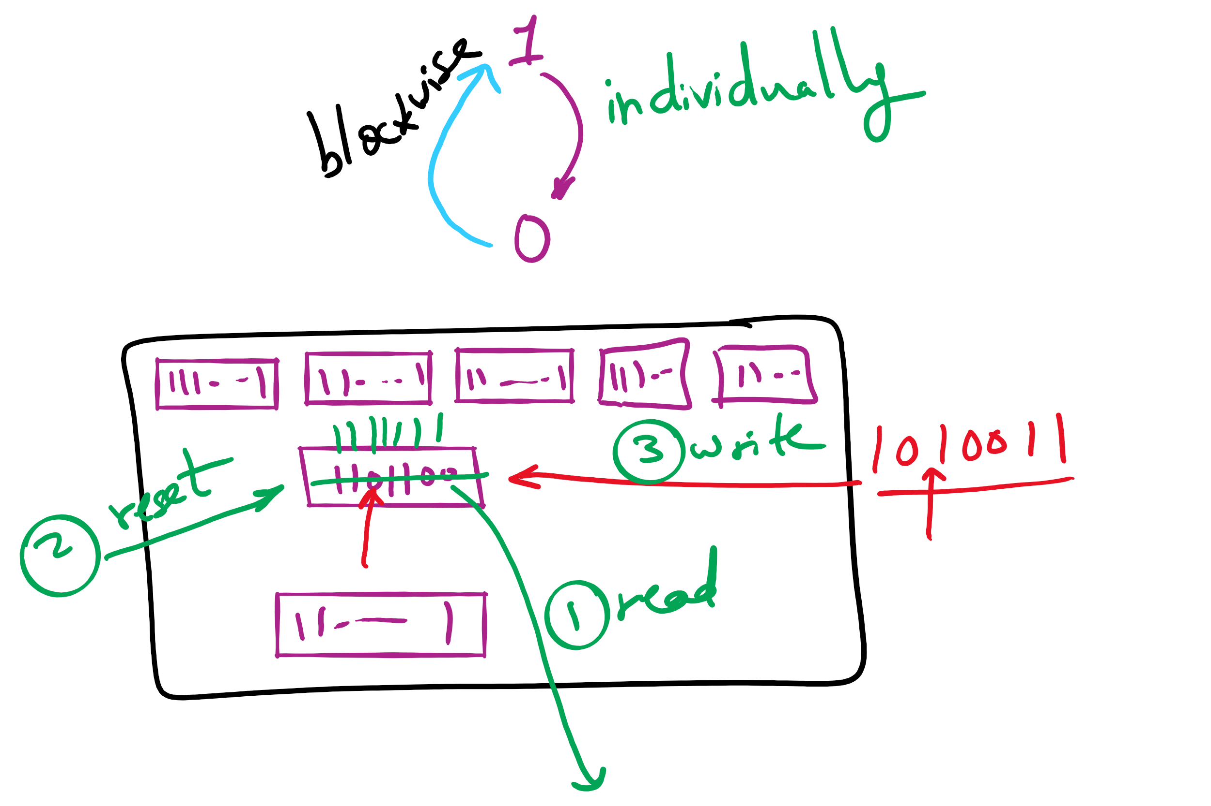
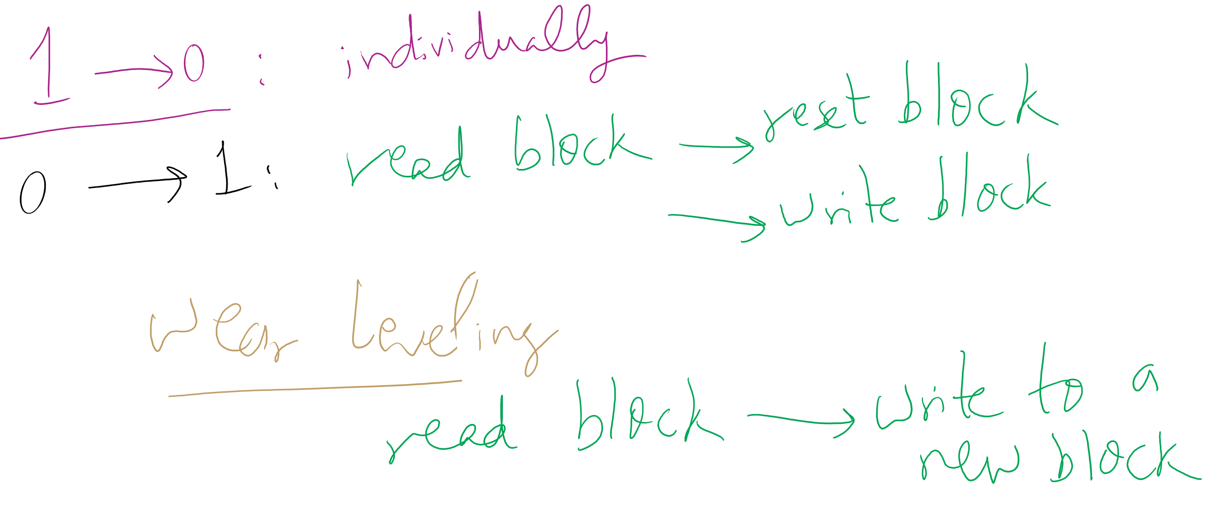
Wear leveling for SSDs

Slide 11
Log-structured file systems
Trends in disk & memory
Faster CPUs
Larger memories
Result
More memory -> disk caches can also be larger
Increasing number of read requests can come from cache
Thus, most disk accesses will be writes
LFS structures entire disk as a log
All writes initially buffered in memory
Periodically write these to the end of the disk log
When file opened, locate i-node, then find blocks
Issue: what happens when blocks are deleted?

Slide 12
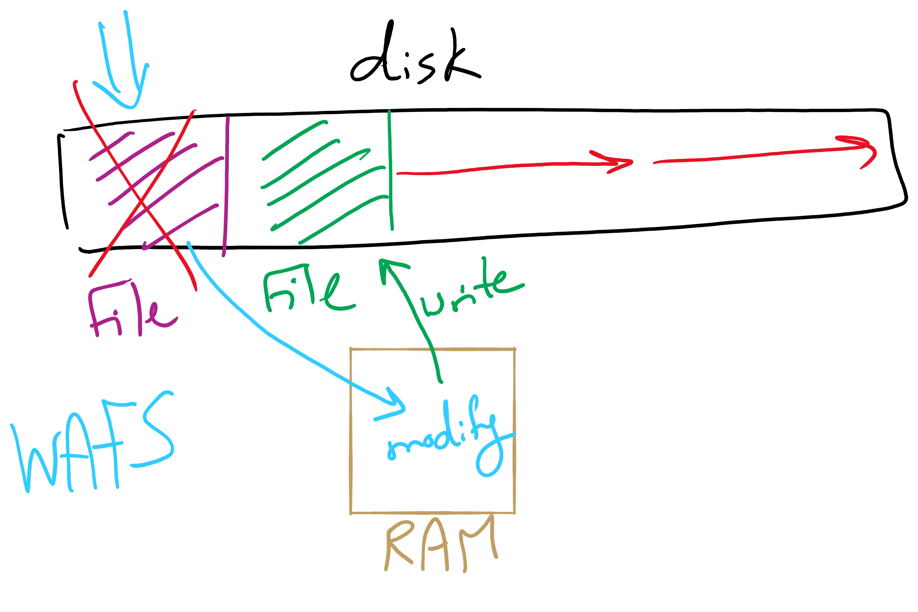
Log Structured File System

Slide 13
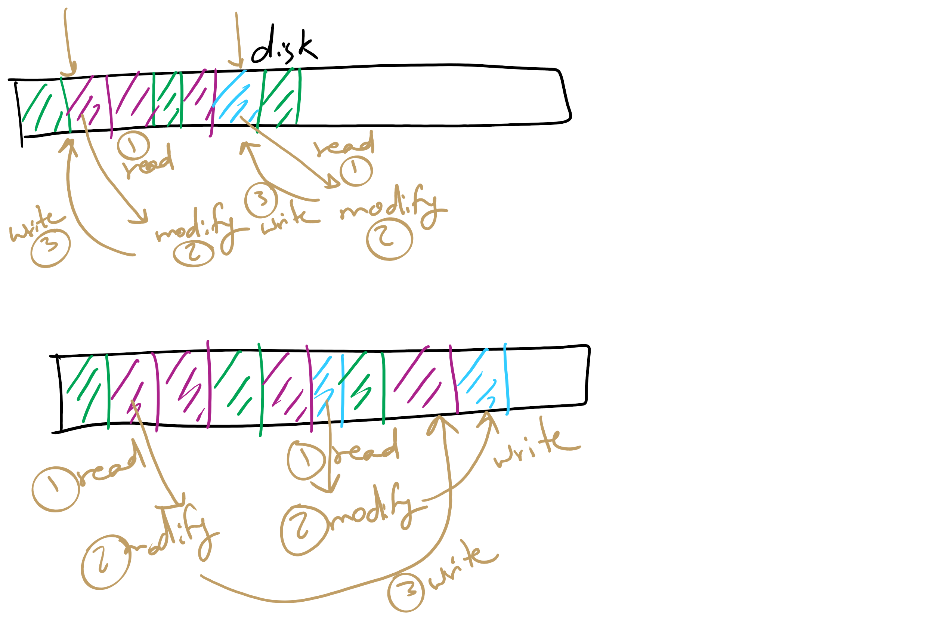
Log Structured File System

Slide 14
Disk drive structure
Data stored on surfaces
Up to two surfaces per platter
One or more platters per disk
Data in concentric tracks
Tracks broken into sectors
256B-1KB per sector
Cylinder: corresponding tracks on all surfaces
Data read and written by heads
Actuator moves heads
Heads move in unison
head
sector
platter
track
cylinder
surfaces
spindle
actuator

Slide 15
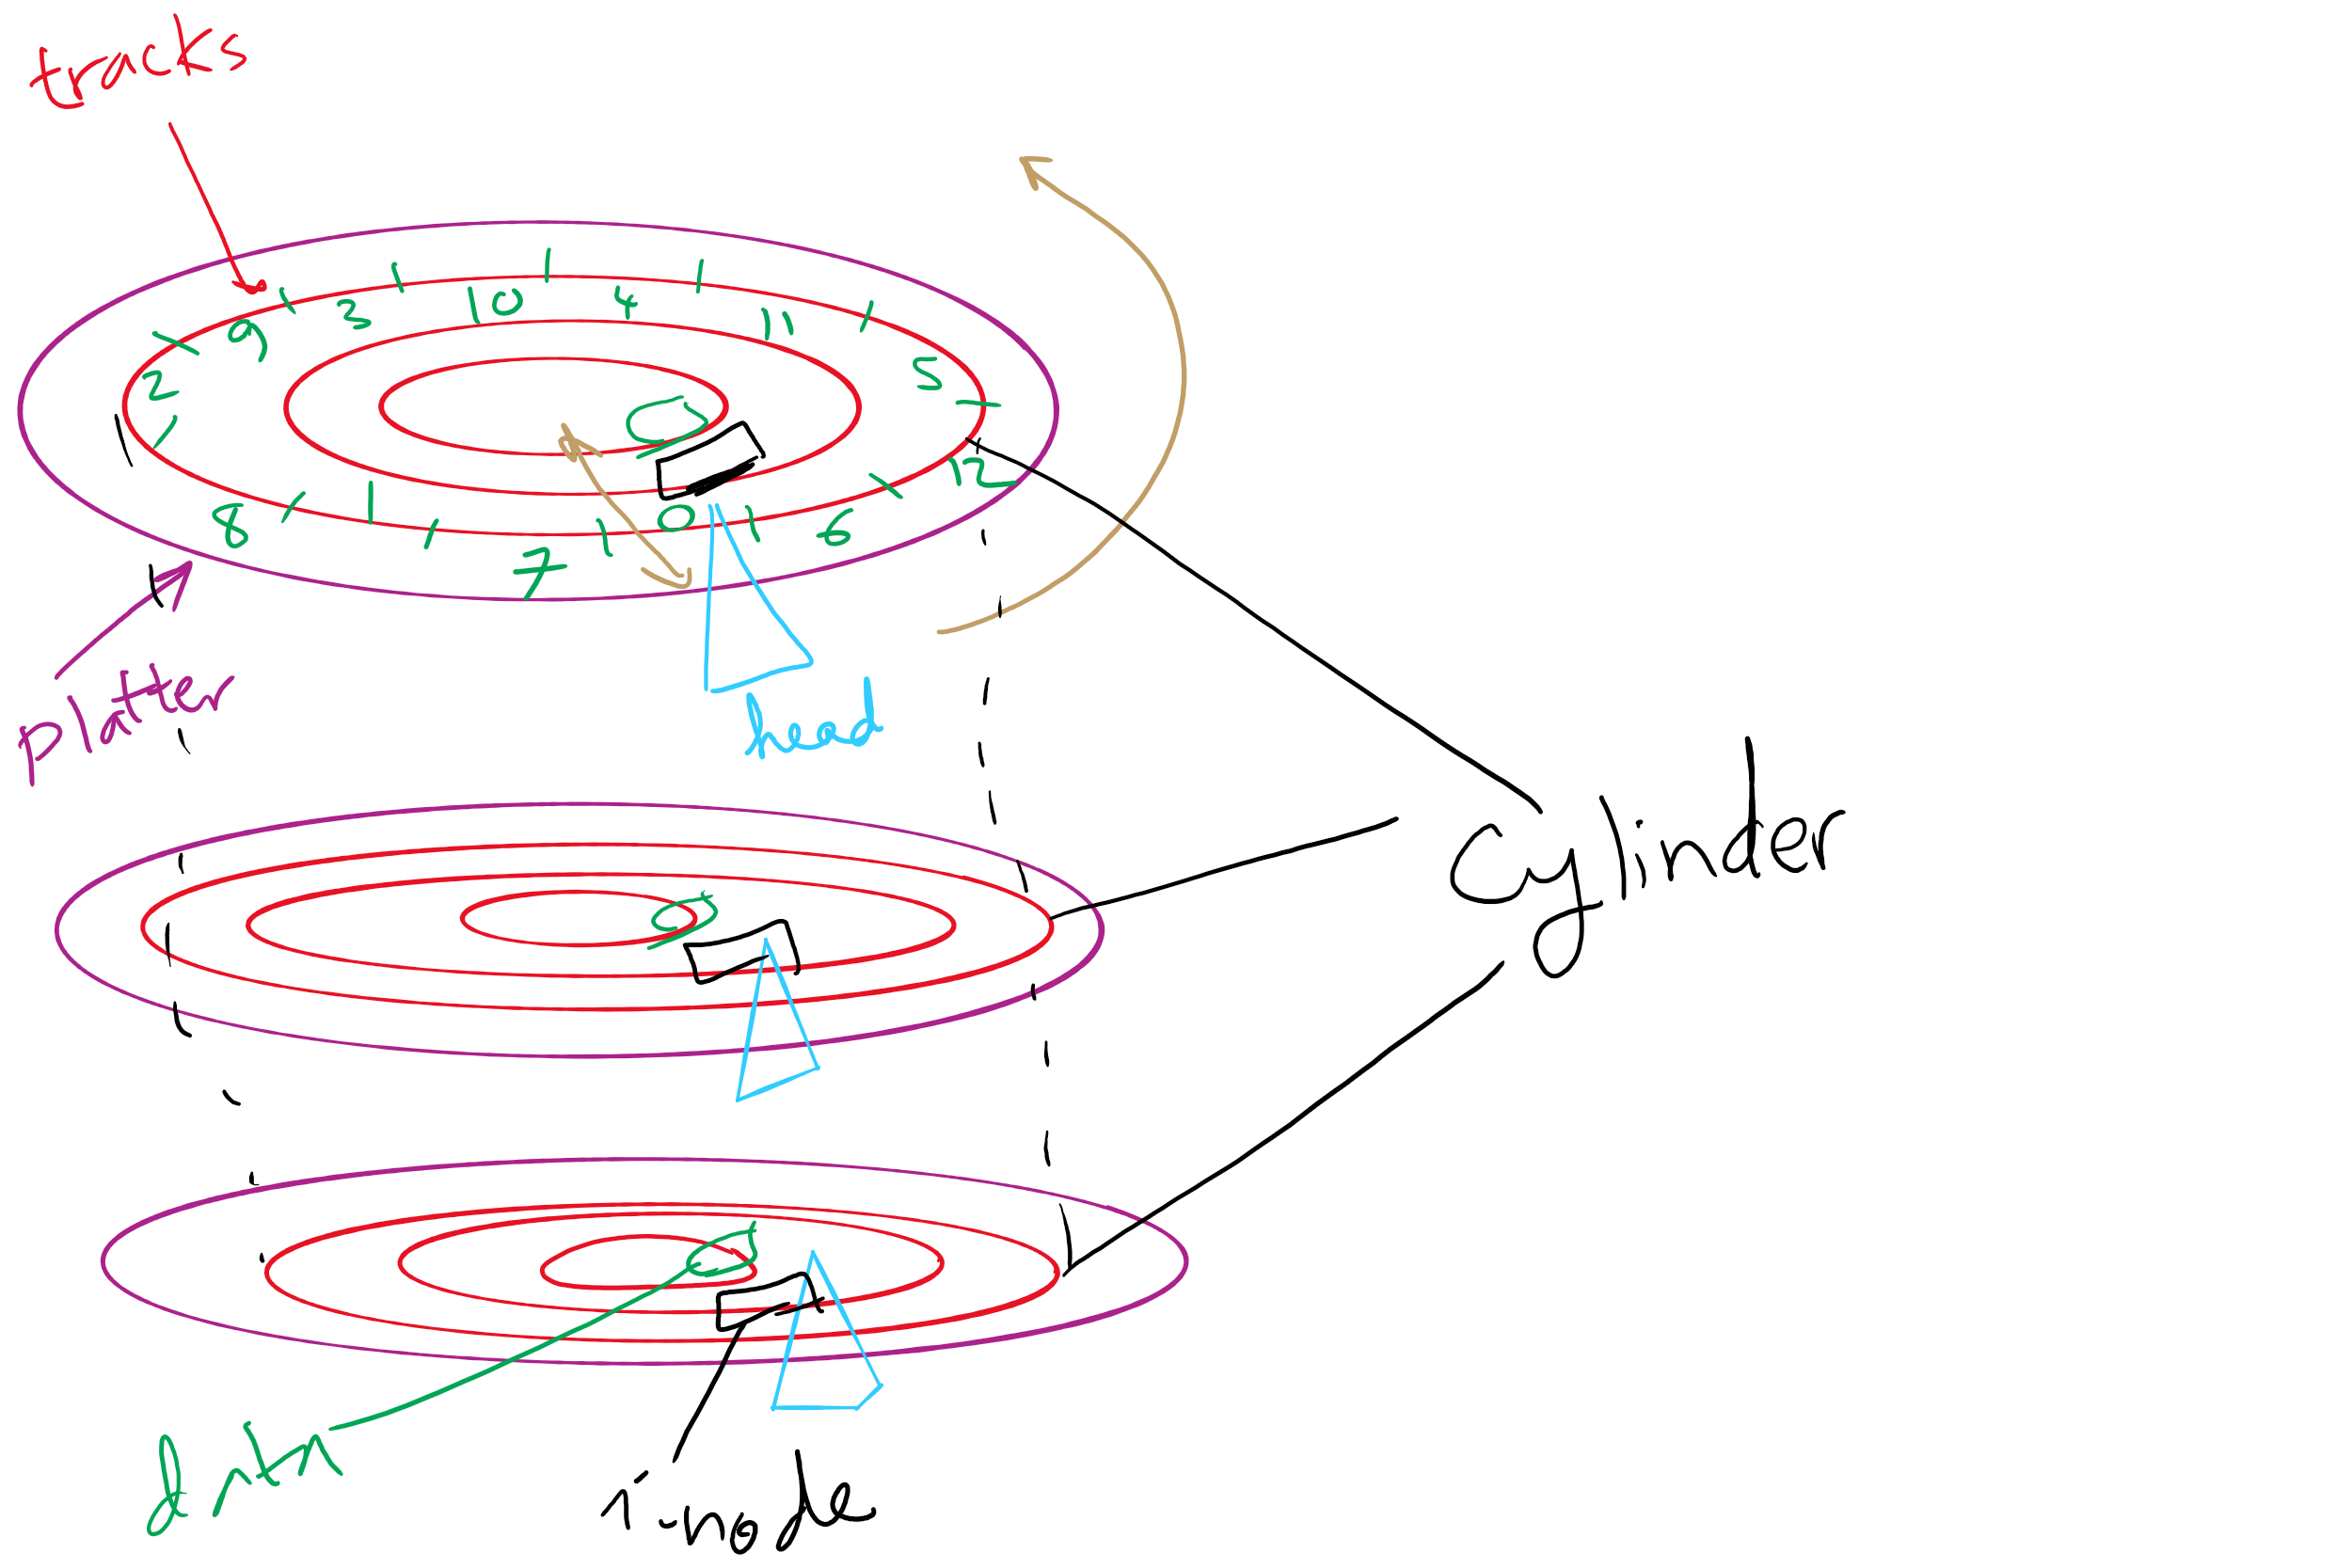
Disks, cylinders, cylinder groups

Slide 16
What’s in a disk request?
Time required to read or write a disk block determined by 3 factors
Seek time
Rotational delay
Average delay = 1/2 rotation time
Example: rotate in 10ms, average rotation delay = 5ms
Actual transfer time
Transfer time = time to rotate over sector
Example: rotate in 10ms, 200 sectors/track => 10/200 ms = 0.05ms transfer time per sector
Seek time dominates, with rotation time close
Error checking is done by controllers

Slide 17
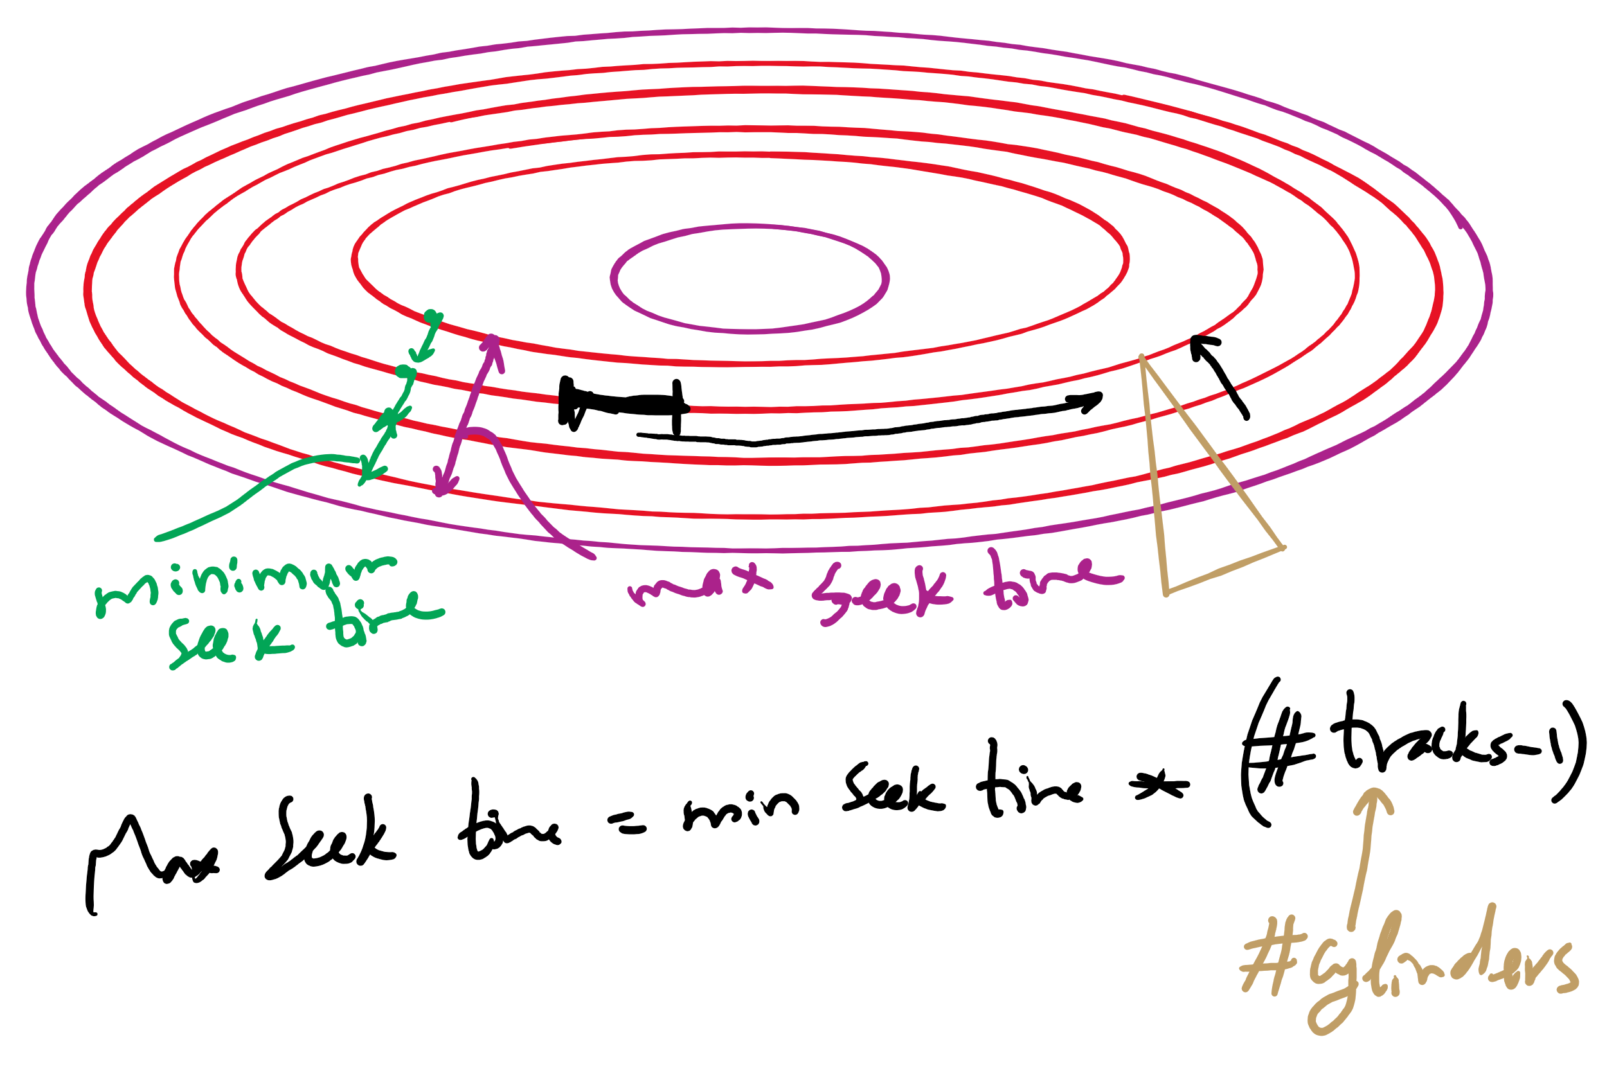
Minimum and Maximum Seek Time

Slide 18
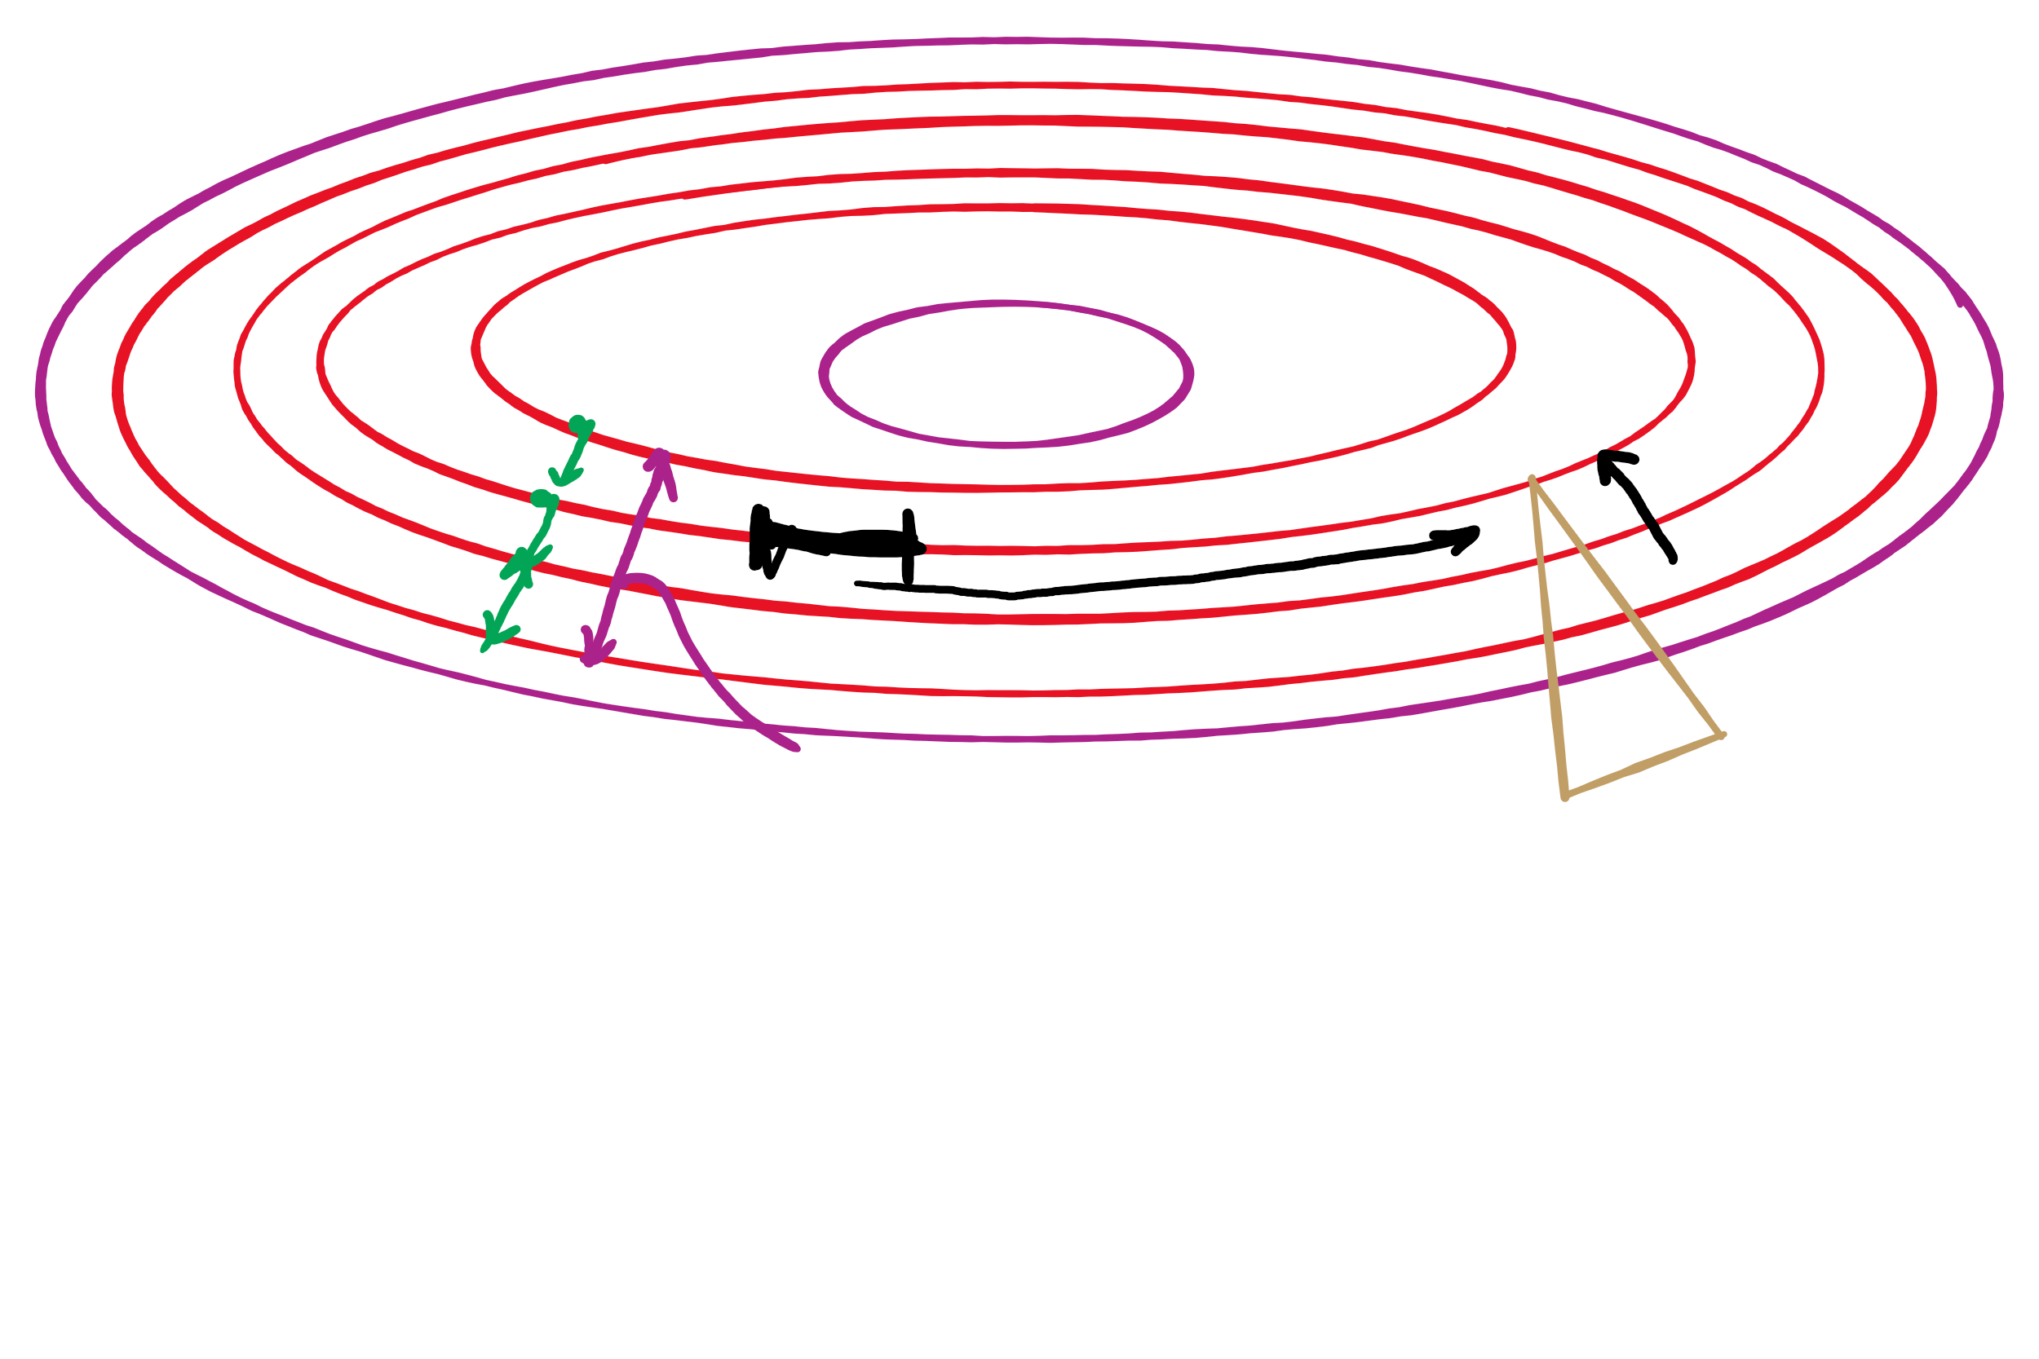
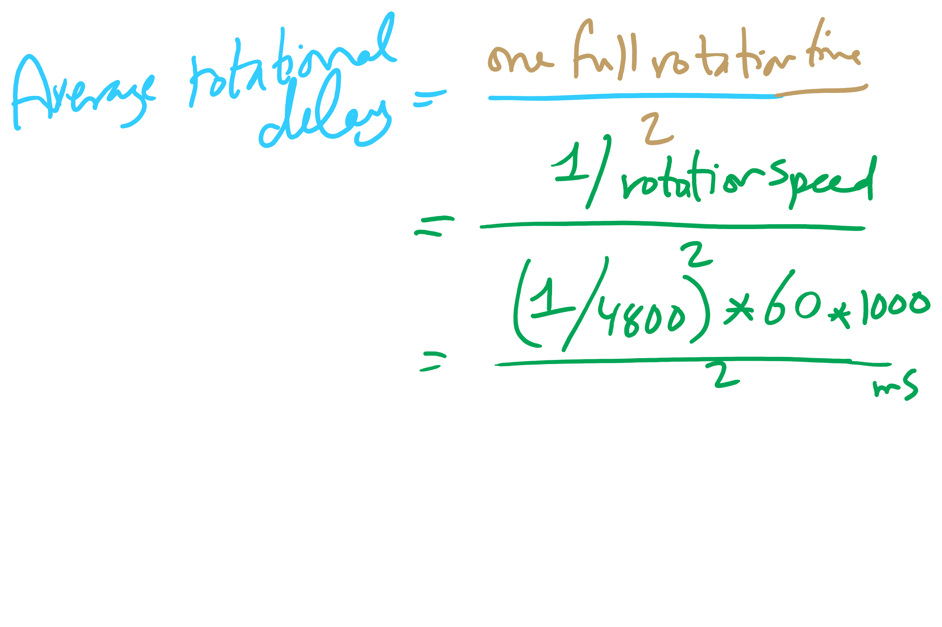
Average Rotational Delay

Slide 19
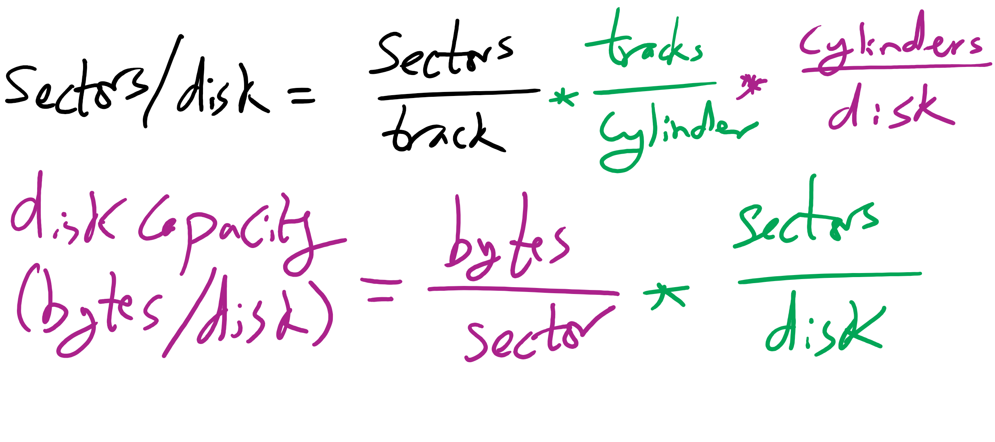
Disk Size

Slide 20
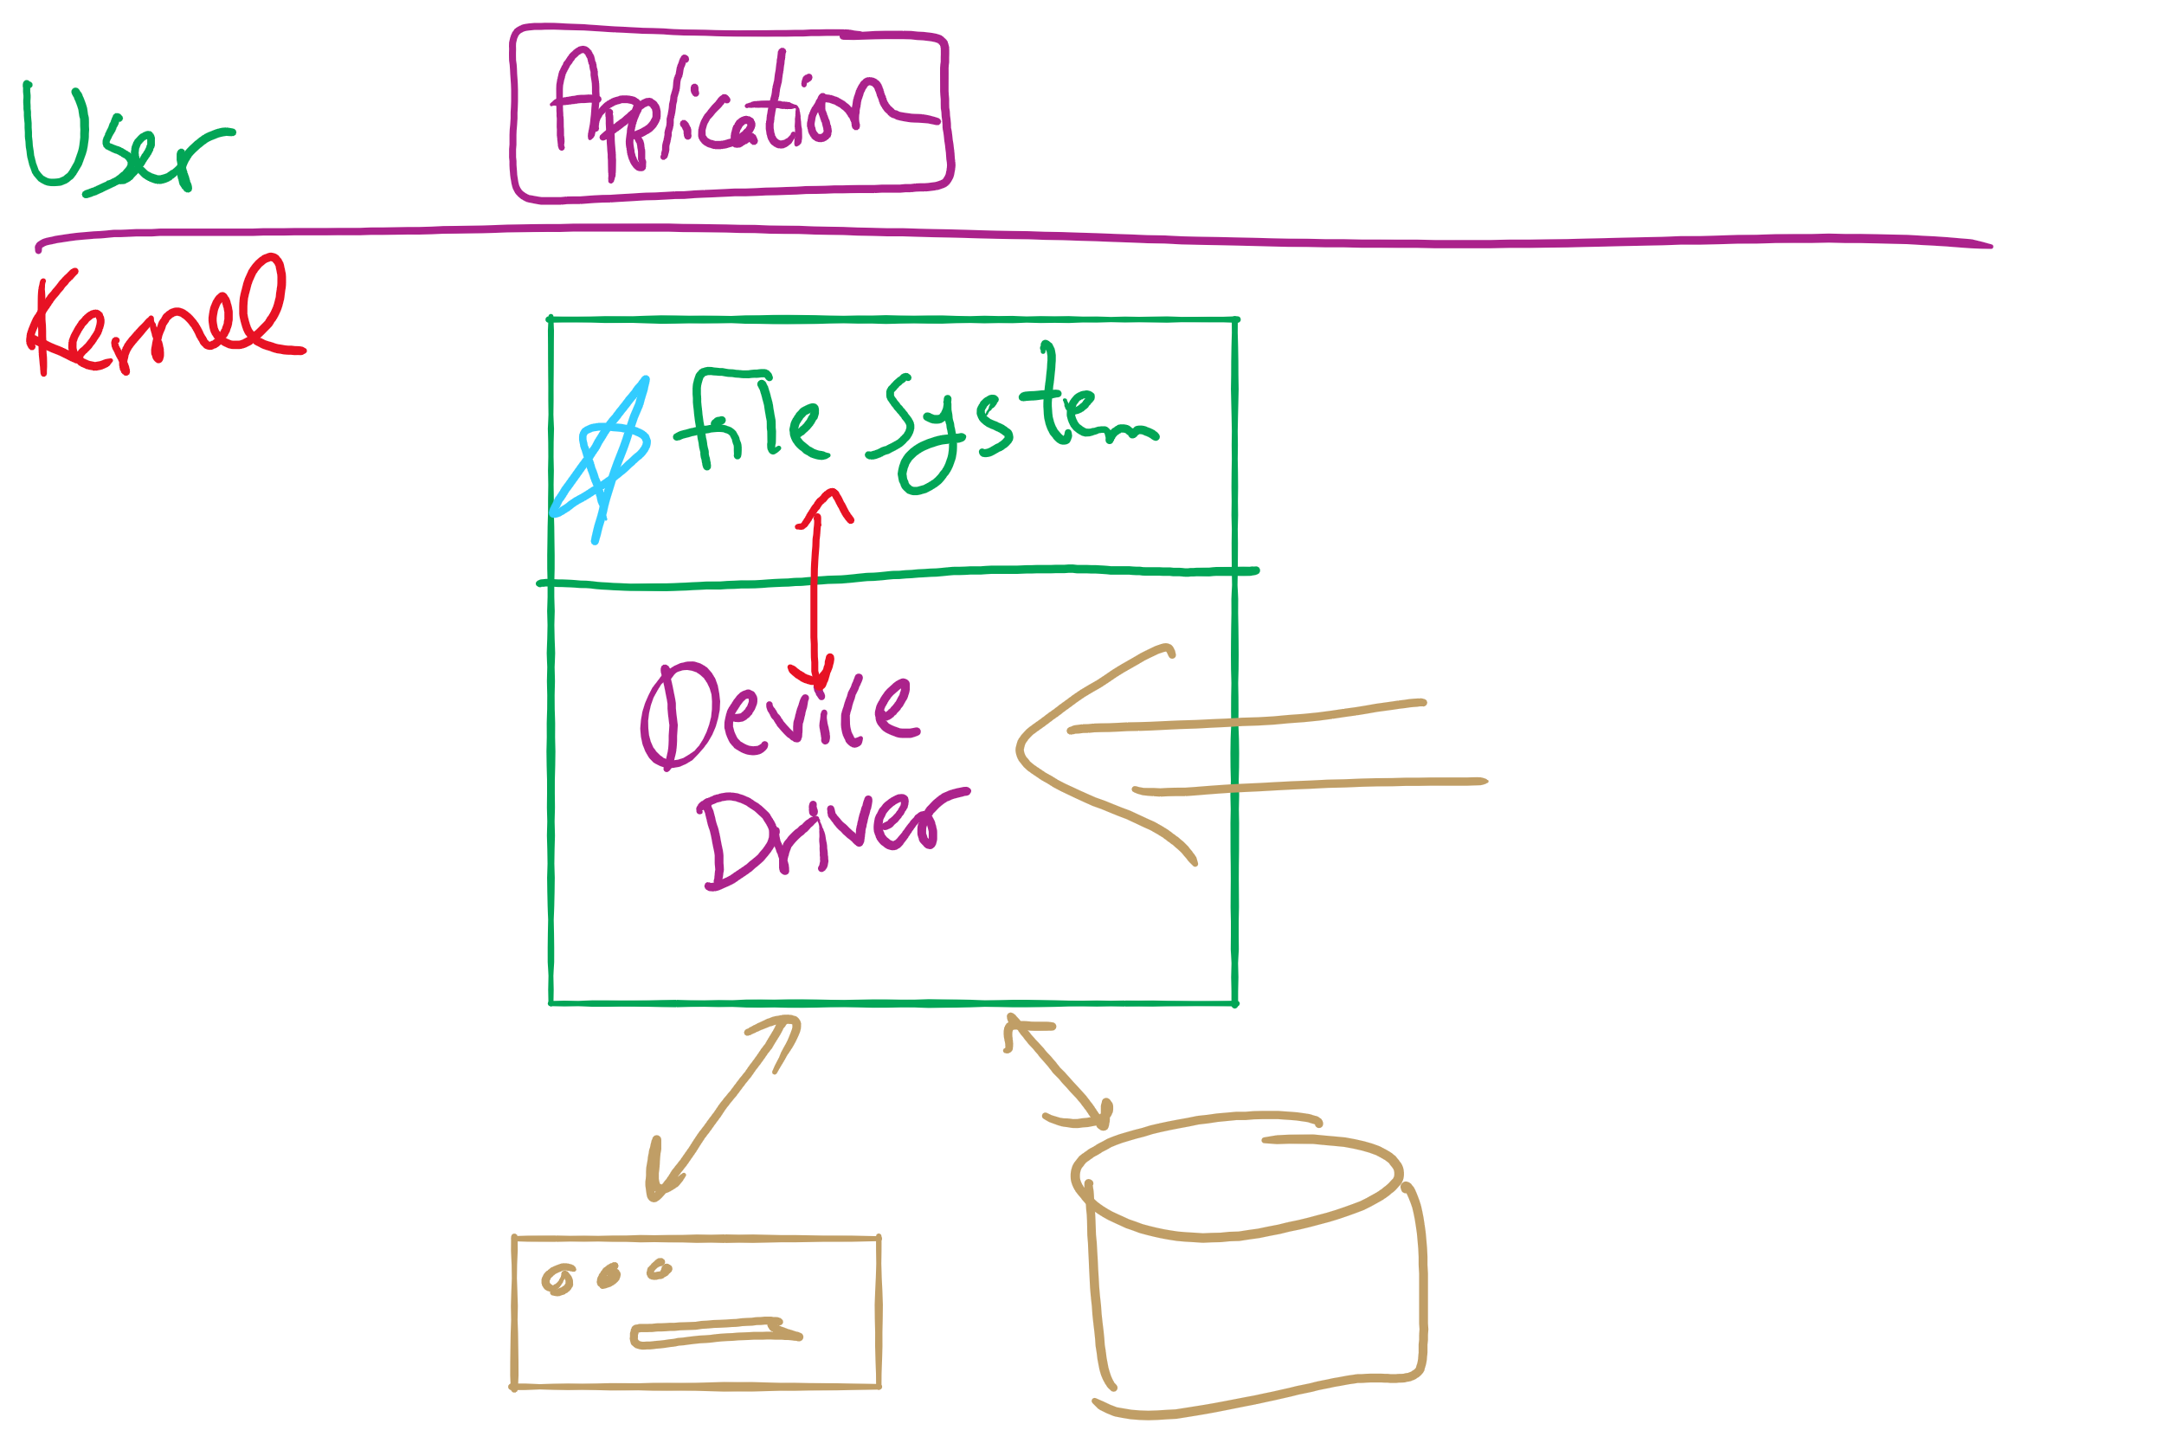
Software Stack

Slide 21
Memory-Mapped vs. separate I/O Space
Memory
0xFFF…
I/O ports
0
Separate I/O & memory space
Memory-mapped I/O
Hybrid: both memory-mapped & separate spaces

Slide 22
Programmed I/O example: printing a page
User
Printed page
Printed page
Printed page
ABCD EFGH
ABCD EFGH
ABCD EFGH
A
AB
Kernel
ABCD EFGH
ABCD EFGH

Slide 23
Polling
copy_from_user (buffer, p, count); // copy into kernel buffer
for (j = 0; j < count; j++) { // loop for each char
while (*printer_status_reg != READY)
; // wait for printer to be ready
*printer_data_reg = p[j]; // output a single character
}
return_to_user();

Slide 24
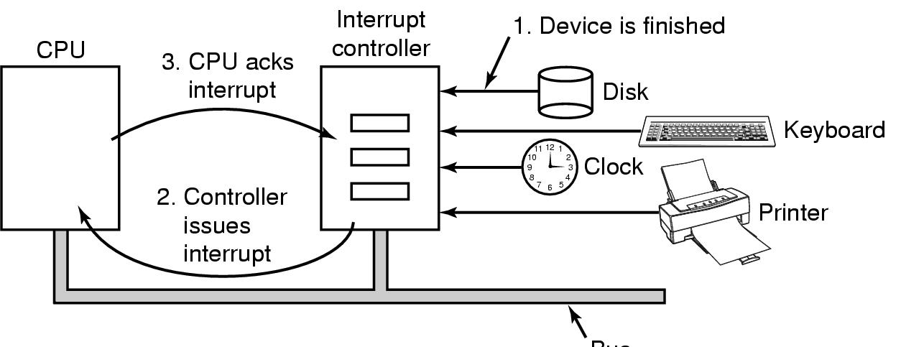
Hardware’s view of interrupts
Bus

Slide 25
Interrupt-driven I/O
copy_from_user (buffer, p, count);
j = 0;
enable_interrupts();
while (*printer_status_reg != READY)
;
*printer_data_reg = p[0];
scheduler(); // and block user
Code run by system call
if (count == 0) {
unblock_user();
} else {
j++;
*printer_data_reg = p[j];
count--;
}
acknowledge_interrupt();
return_from_interrupt();
Code run at interrupt time
(Interrupt handler)

Slide 26
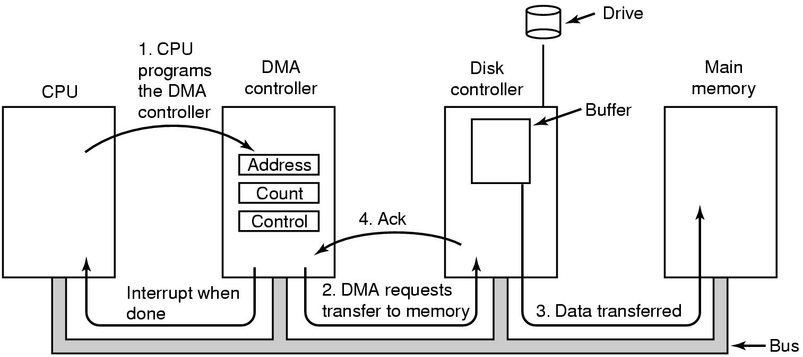
Direct Memory Access (DMA) operation

Slide 27
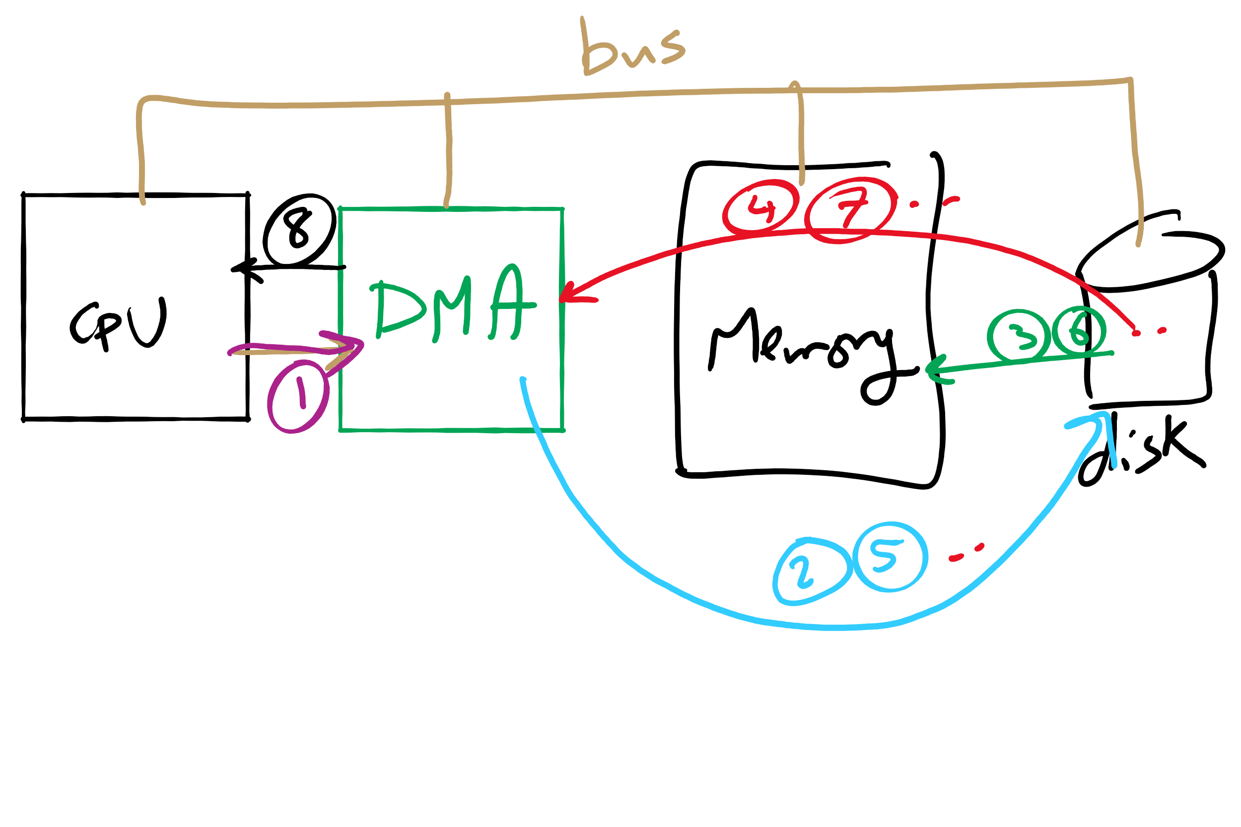
DMA

Slide 28
I/O using DMA
copy_from_user (buffer, p, count);
set_up_DMA_controller();
scheduler(); // and block user
Code run by system call
acknowledge_interrupt();
unblock_user();
return_from_interrupt();
Code run at interrupt time

Slide 29
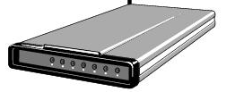
Buffering device input
User space
User space
User space
User space
Kernel space
Kernel space
Kernel space
Kernel space
2
2
1
1
3
Unbuffered input
Buffering in user space
Buffer in kernel Copy to user space
Double buffer in kernel

Slide 30
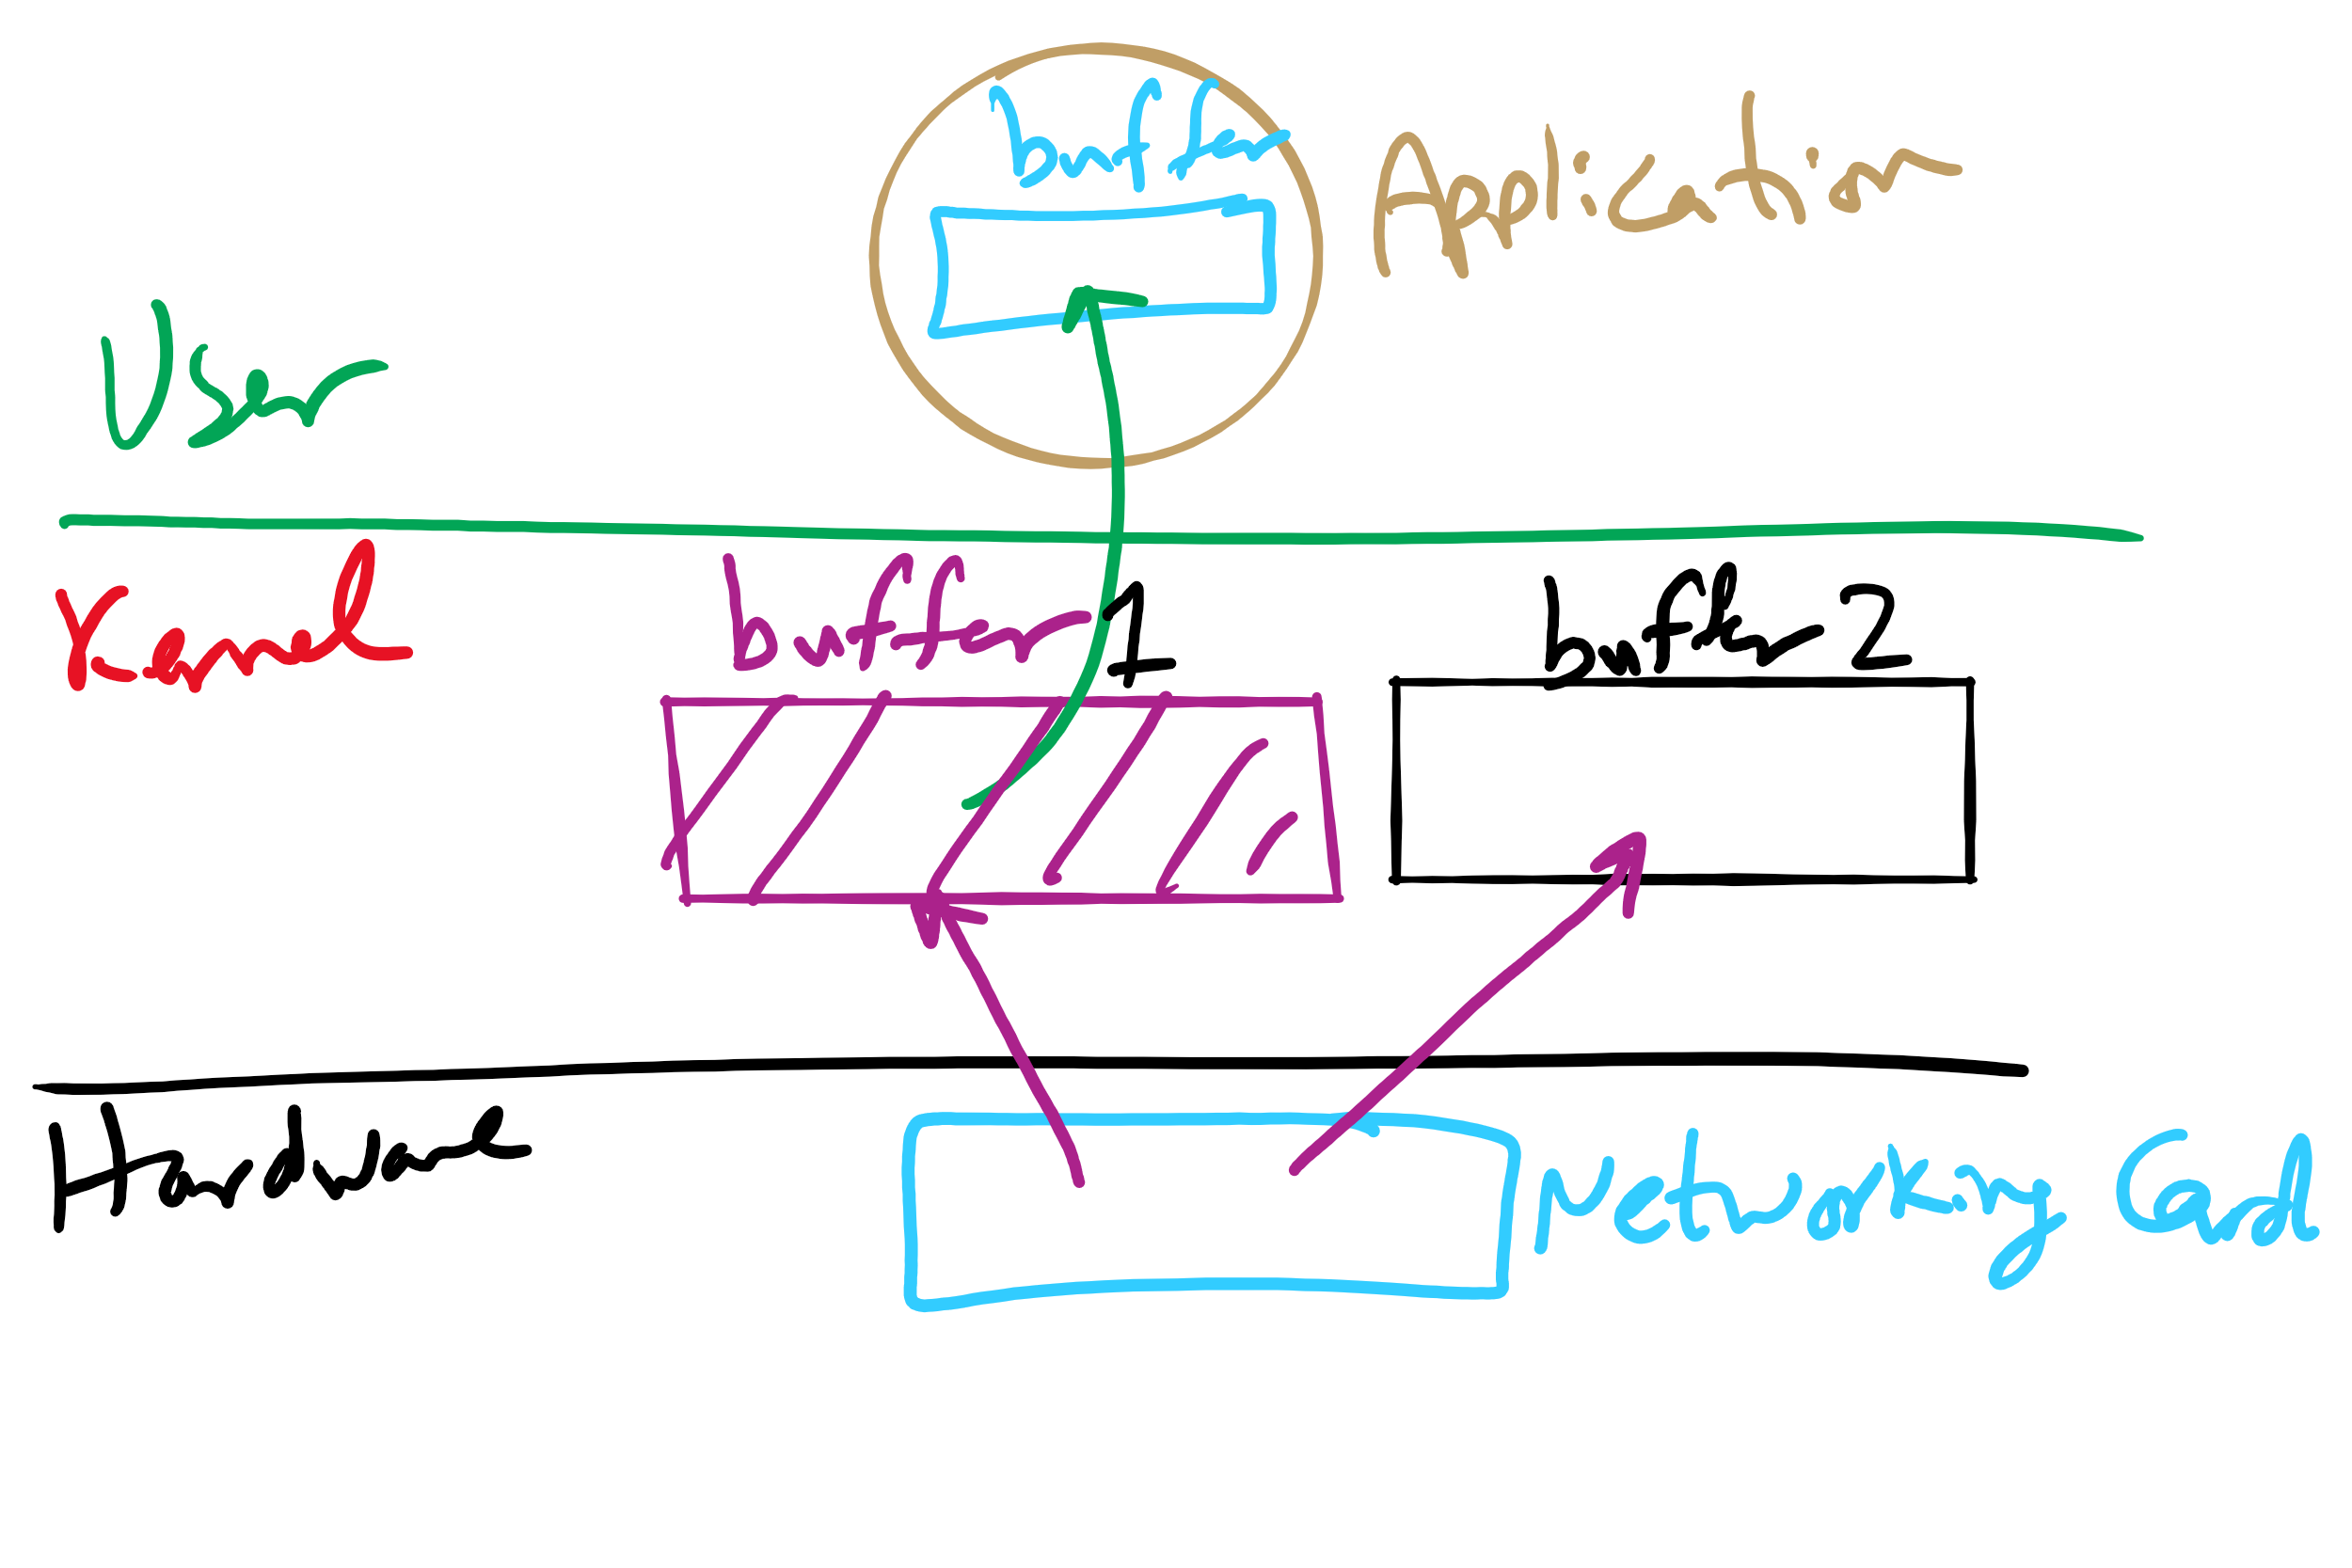
I/O Buffering

Slide 31
Disk drive structure
Data stored on surfaces
Up to two surfaces per platter
One or more platters per disk
Data in concentric tracks
Tracks broken into sectors
256B-1KB per sector
Cylinder: corresponding tracks on all surfaces
Data read and written by heads
Actuator moves heads
Heads move in unison
head
sector
platter
track
cylinder
surfaces
spindle
actuator

Slide 32
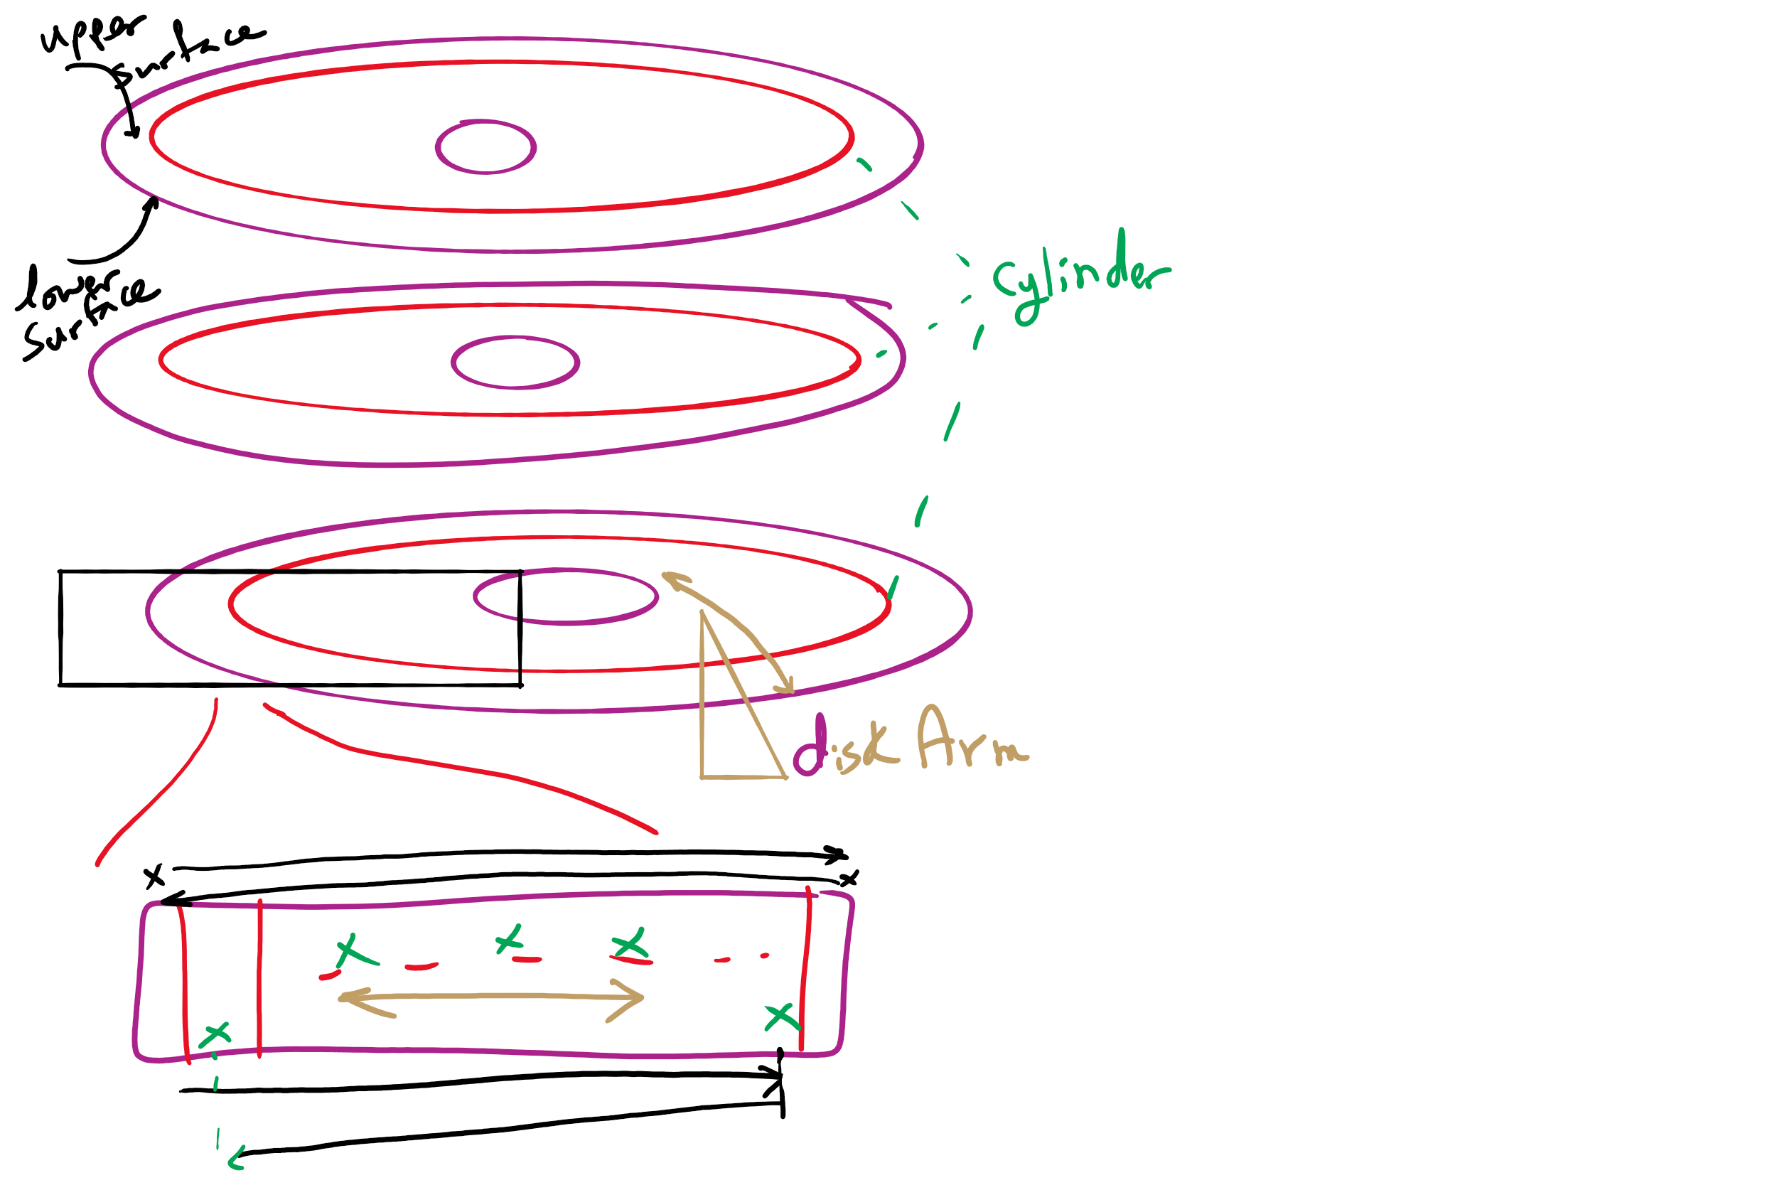
Disk Arm Scheduling

Slide 33
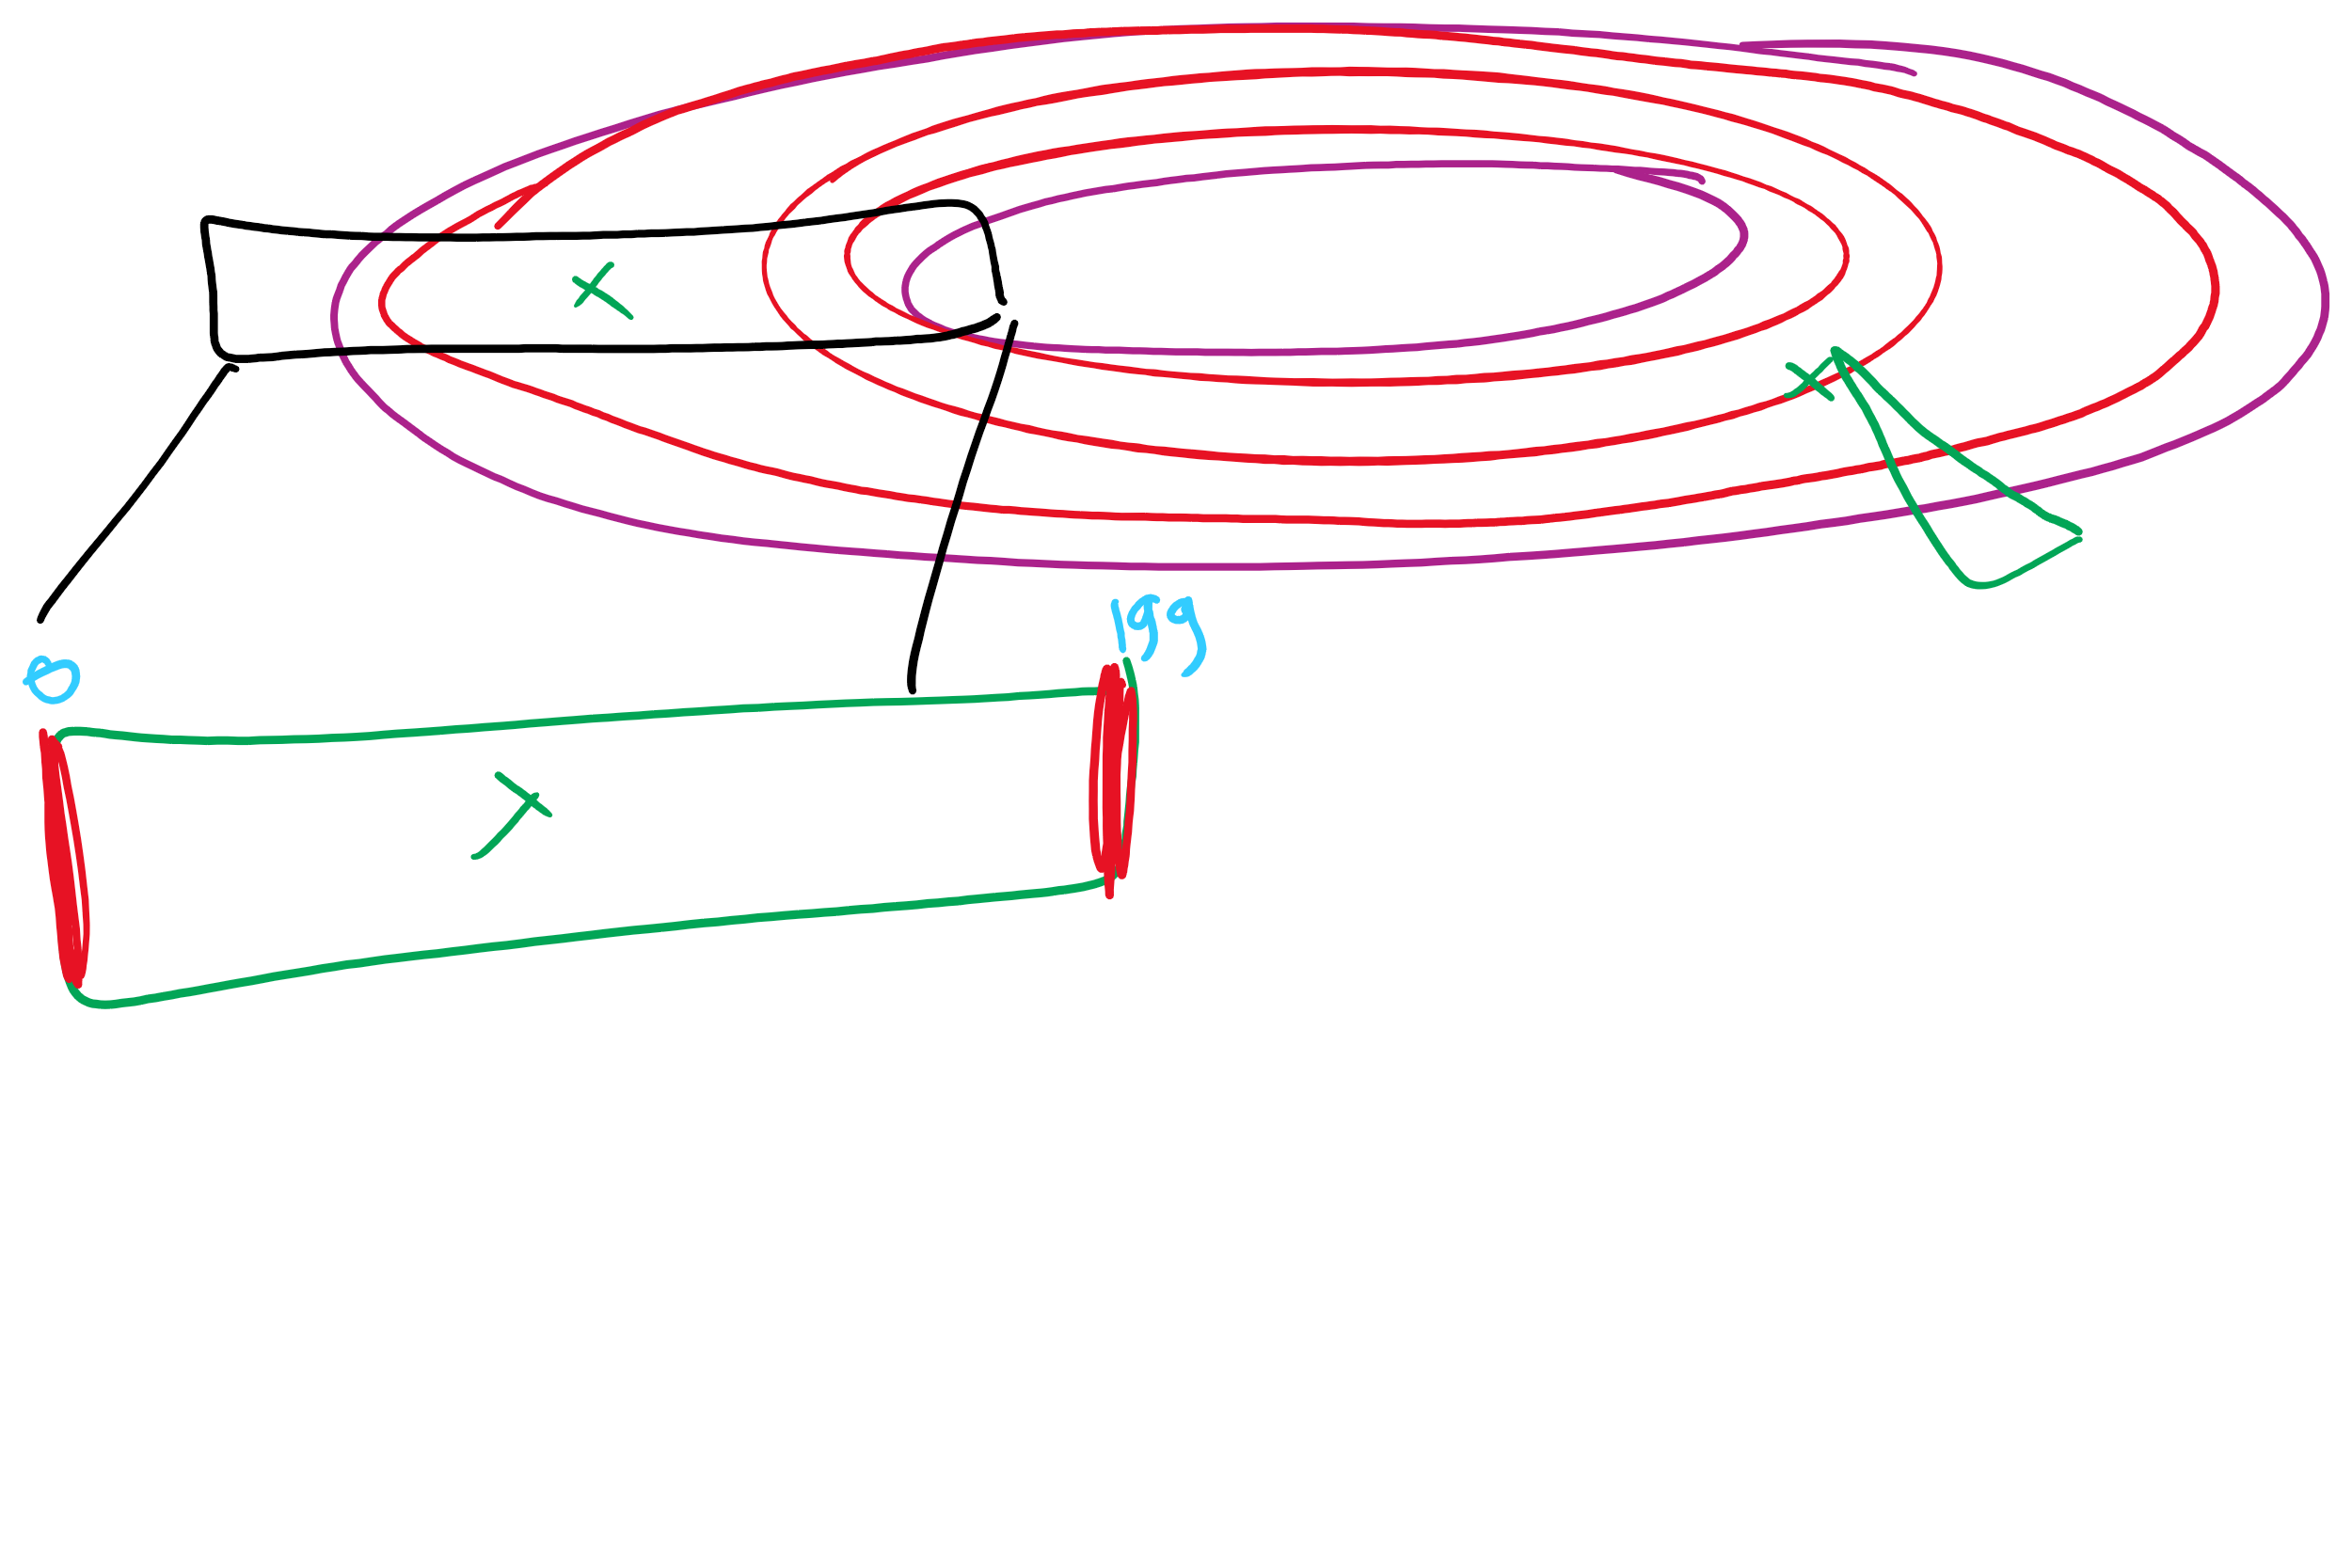
Disk scheduling algorithms
Schedule disk requests to minimize disk seek time
Seek time increases as distance increases (though not linearly)
Minimize seek distance -> minimize seek time
Disk seek algorithm examples assume a request queue & head position (disk has 200 cylinders)
Queue = 100, 175, 51, 133, 8, 140, 73, 77
Head position = 63
Outside edge
Inside edge
8
51
73
100
133
175
77
140
read/write head position
disk requests
(cylinder in which block resides)

Slide 34
First-Come-First Served (FCFS)
Requests serviced in the order in which they arrived
Easy to implement!
May involve lots of unnecessary seek distance
Seek order = 100, 175, 51, 133, 8, 140, 73, 77
Seek distance = (100-63) + (175-100) + (175-51) + (133-51) + (133-8) + (140-8) + (140-73) + (77-73) = 646 cylinders
read/write head start
100
175
51
133
8
140
73
77

Slide 35
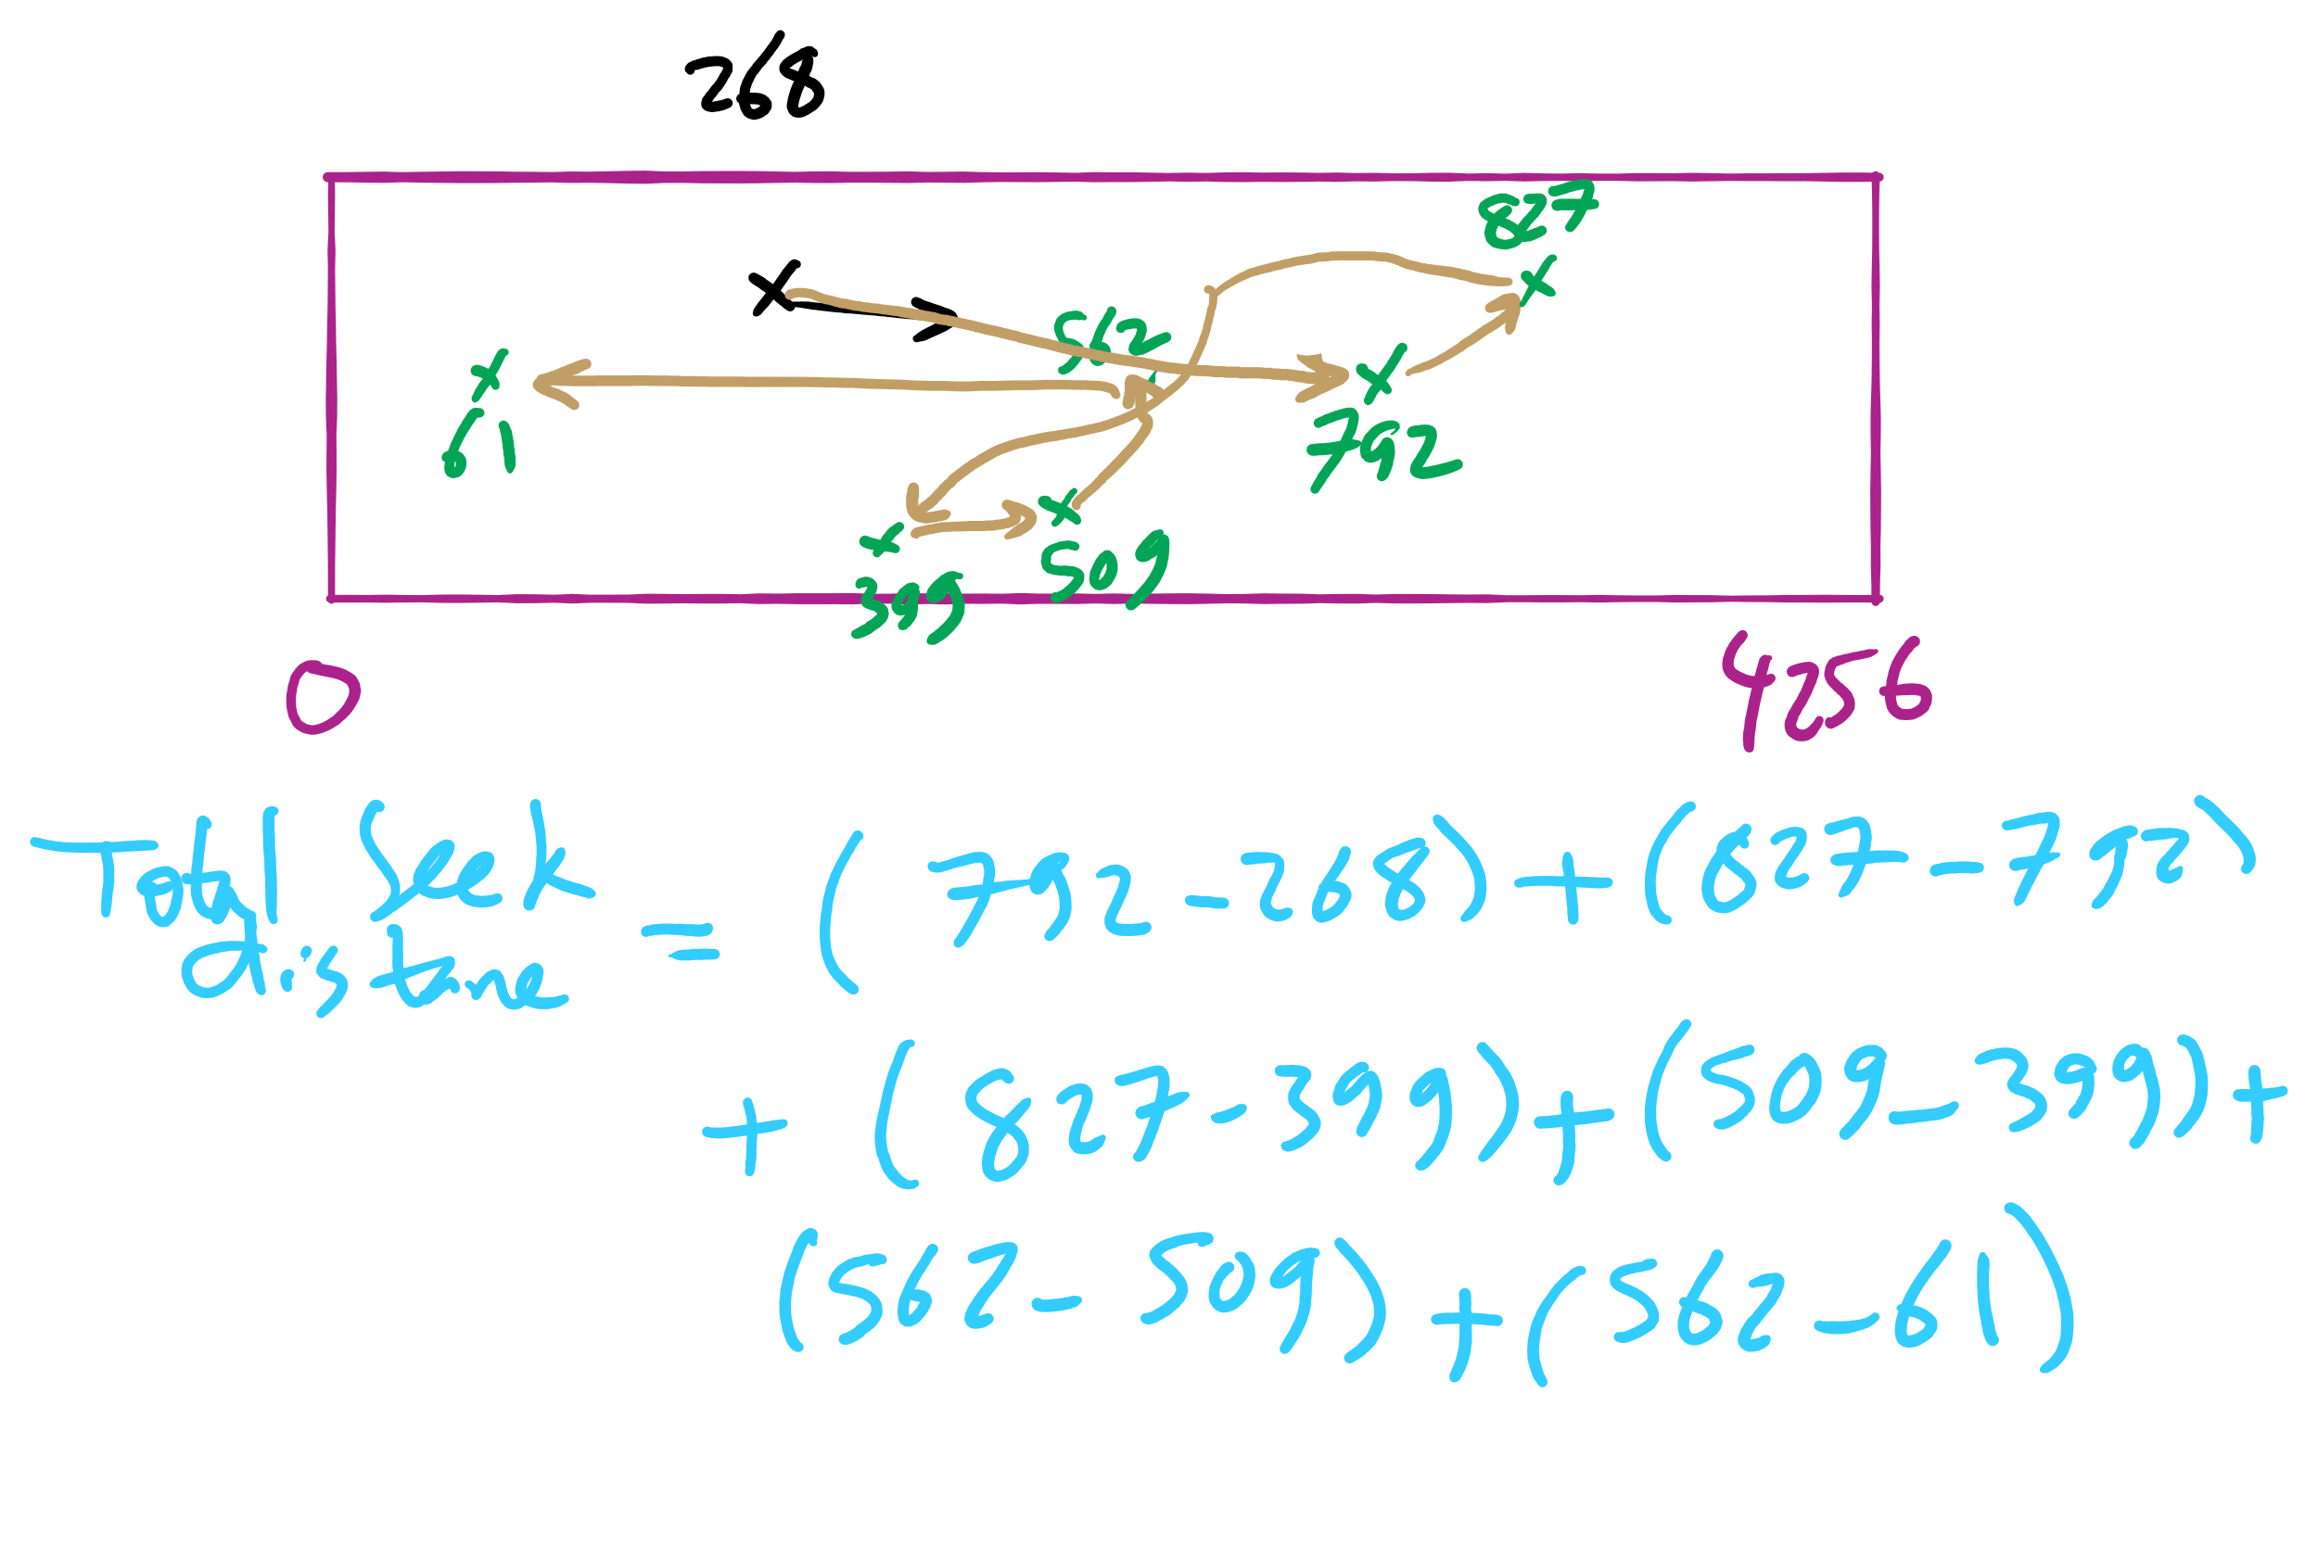
FCFS Example

Slide 36
Shortest Seek Time First (SSTF)
Service the request with the shortest seek time from the current head position
Form of SJF scheduling
May starve some requests
Seek order = 73, 77, 100, 133, 140, 175, 51, 8
Seek distance = 10 + 4 + 23 + 33 + 7 + 35 + 124 + 43 = 279 cylinders
read/write head start
73
77
51
8
133
100
140
175

Slide 37
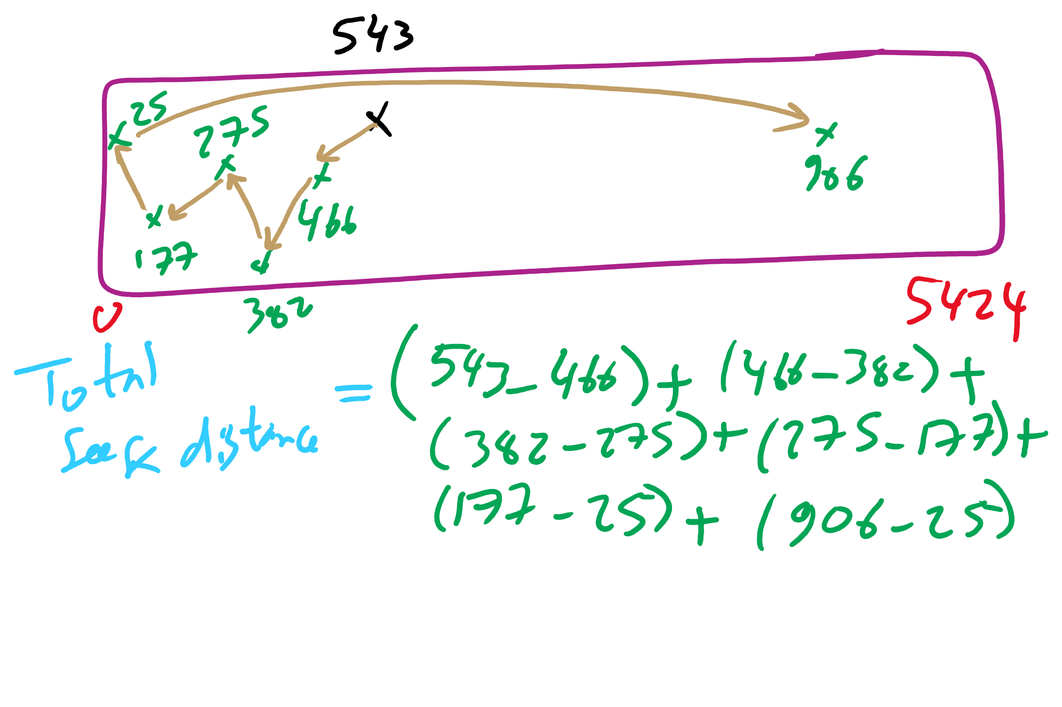
SSTF Example

Slide 38
SCAN (elevator algorithm)
Disk arm starts at one end of the disk and moves towards the other end, servicing requests as it goes
Reverses direction when it gets to end of the disk
Also known as elevator algorithm
Seek order = 51, 8, 0 , 73, 77, 100, 133, 140, 175
Seek distance = 12 + 43 + 8 + 73 + 4 + 23 + 33 + 7 + 35 = 238 cyls
read/write head start
51
8
73
77
100
133
140
175

Slide 39
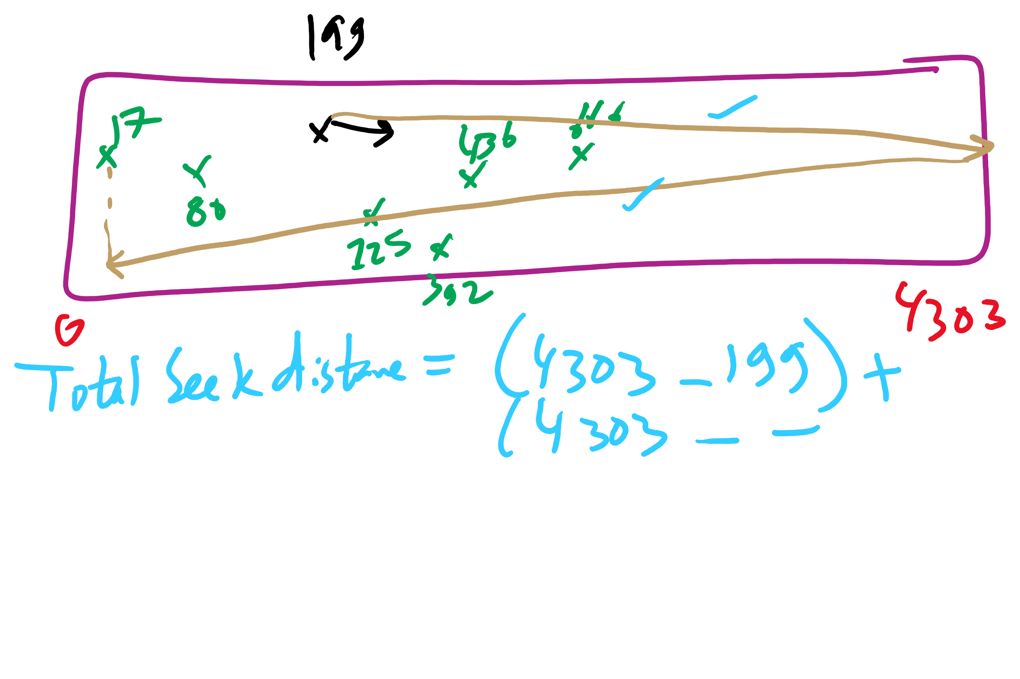
SCAN Example

Slide 40
C-SCAN
Identical to SCAN, except head returns to cylinder 0 when it reaches the end of the disk
Treats cylinder list as a circular list that wraps around the disk
Waiting time is more uniform for cylinders near the edge of the disk
Seek order = 73, 77, 100, 133, 140, 175, 199, 0, 8, 51
Distance = 10 + 4 + 23 + 33 + 7 + 35 + 24 + 199 + 8 + 43 = 386 cyls
read/write head start
73
77
100
133
140
175
8
51

Slide 41
C-LOOK
Identical to C-SCAN, except head only travels as far as the last request in each direction
Saves seek time from last sector to end of disk
Seek order = 73, 77, 100, 133, 140, 175, 8, 51
Distance = 10 + 4 + 23 + 33 + 7 + 35 + 167 + 43 = 322 cylinders
read/write head start
73
77
100
133
140
175
8
51

Slide 42
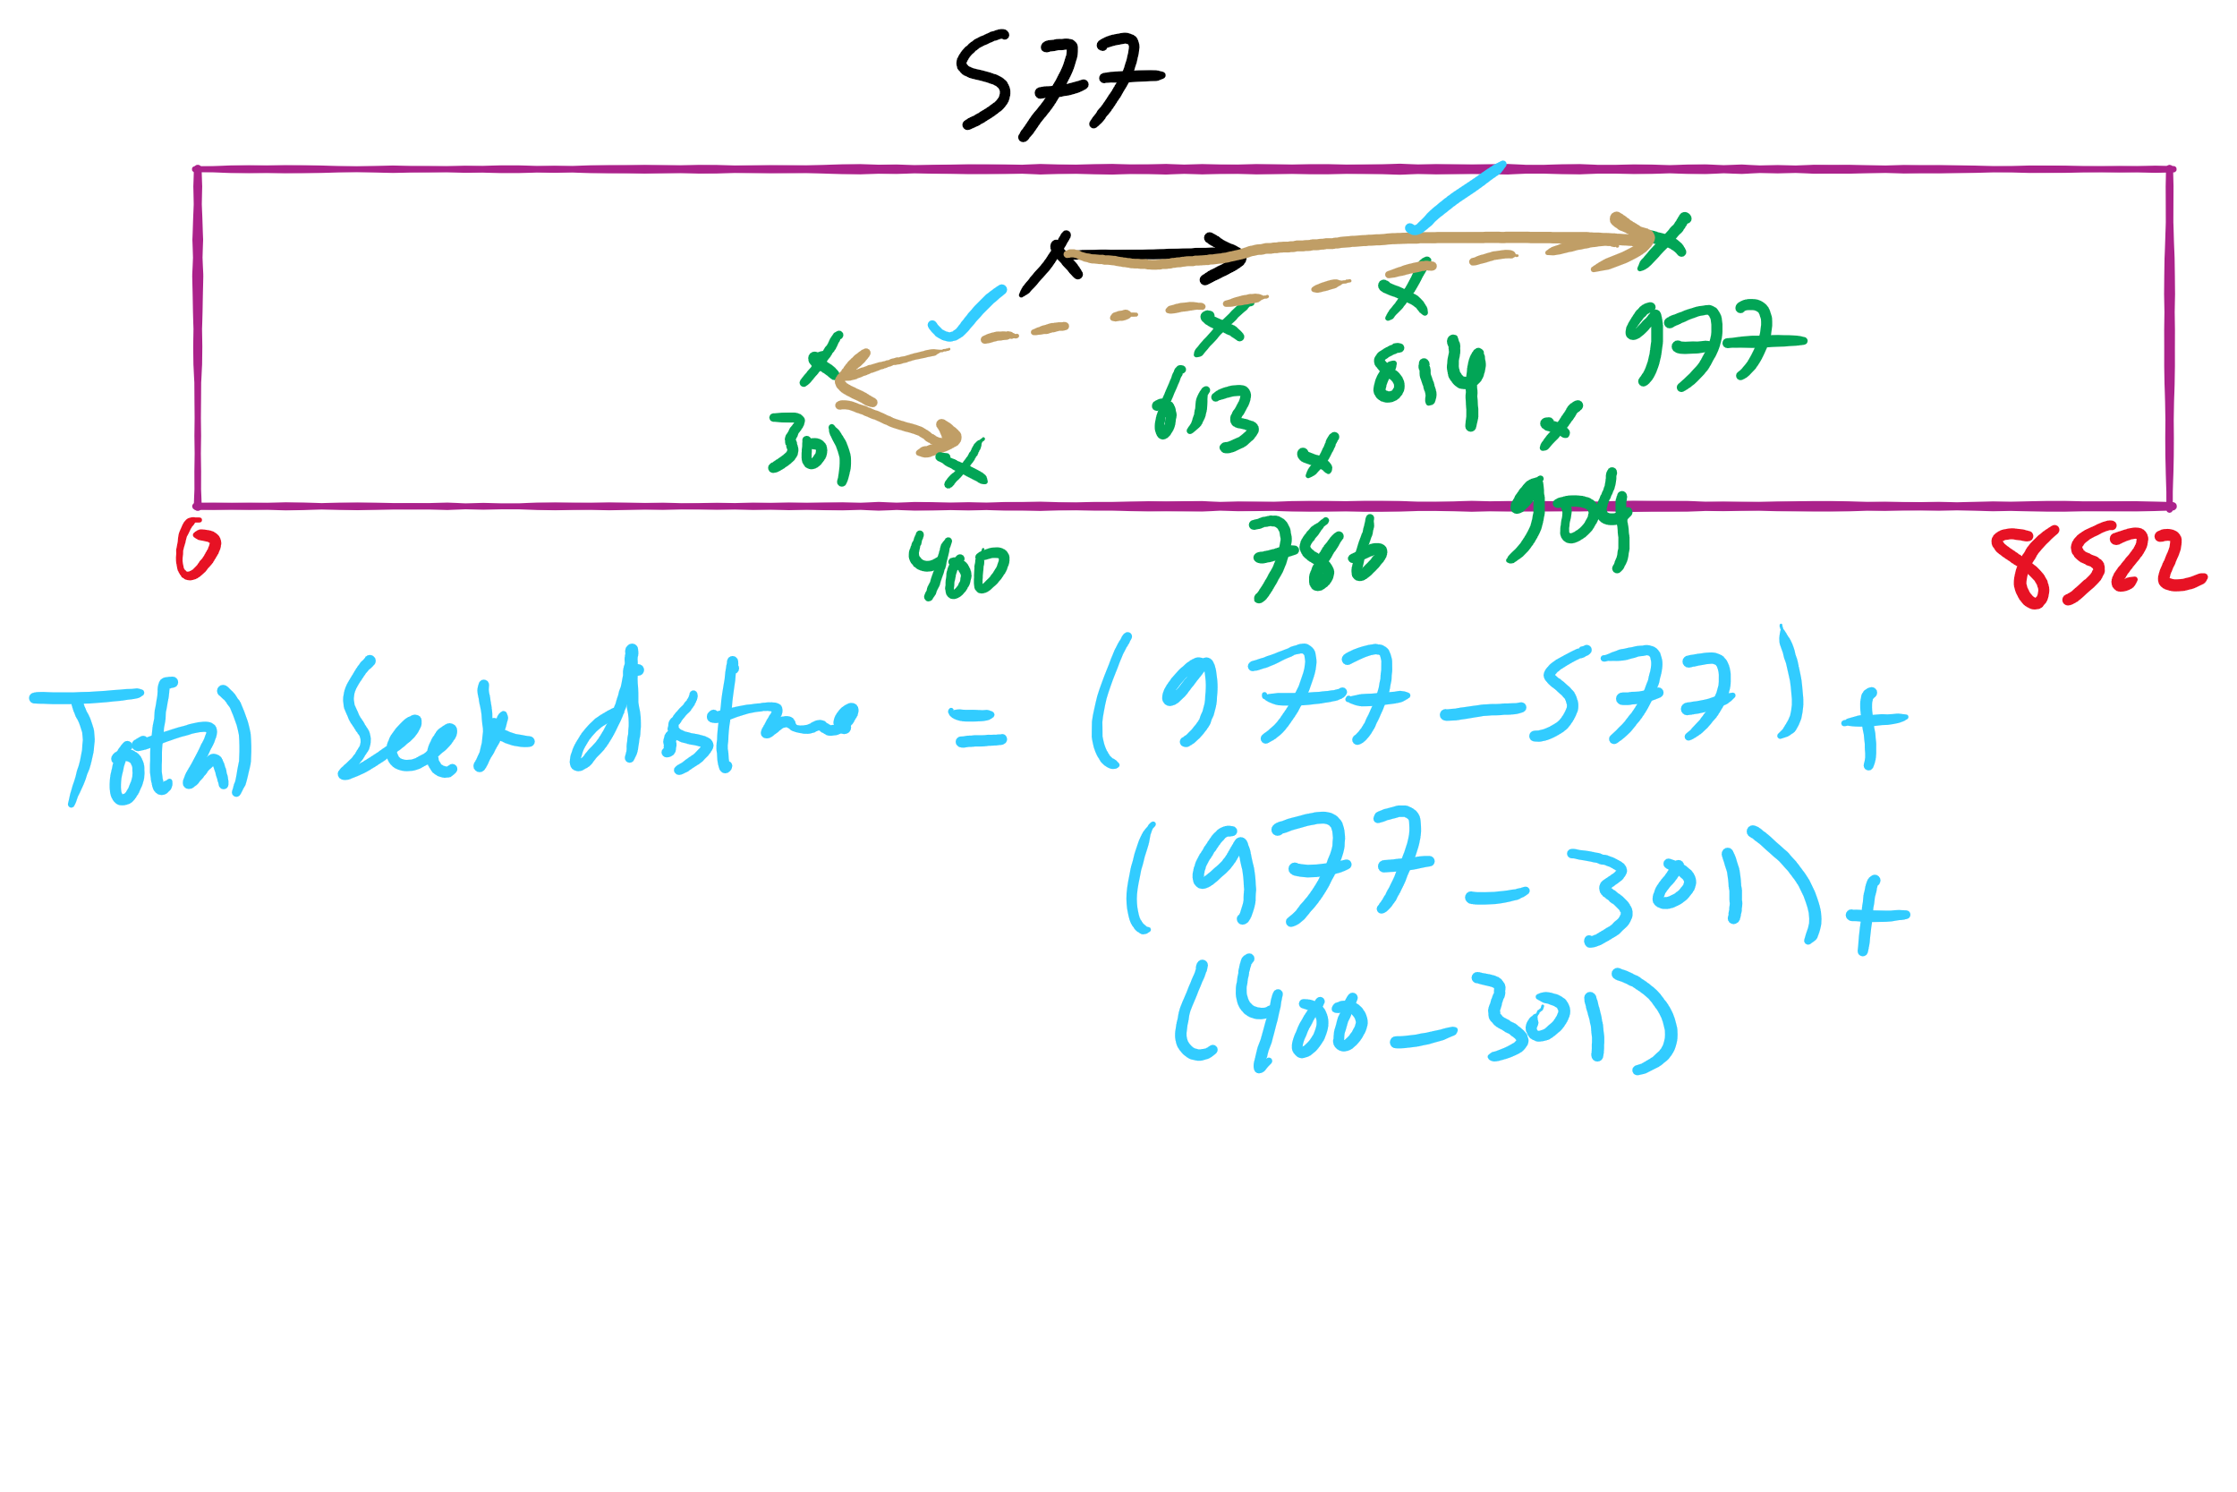
C-LOOK Example

Slide 43
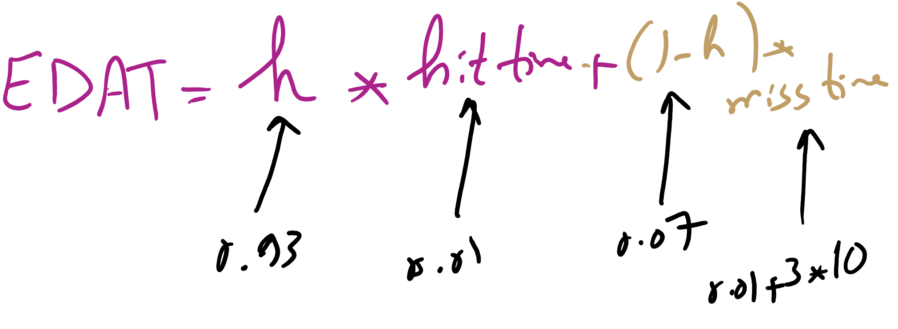
Effective Disk Access Time

Slide 44
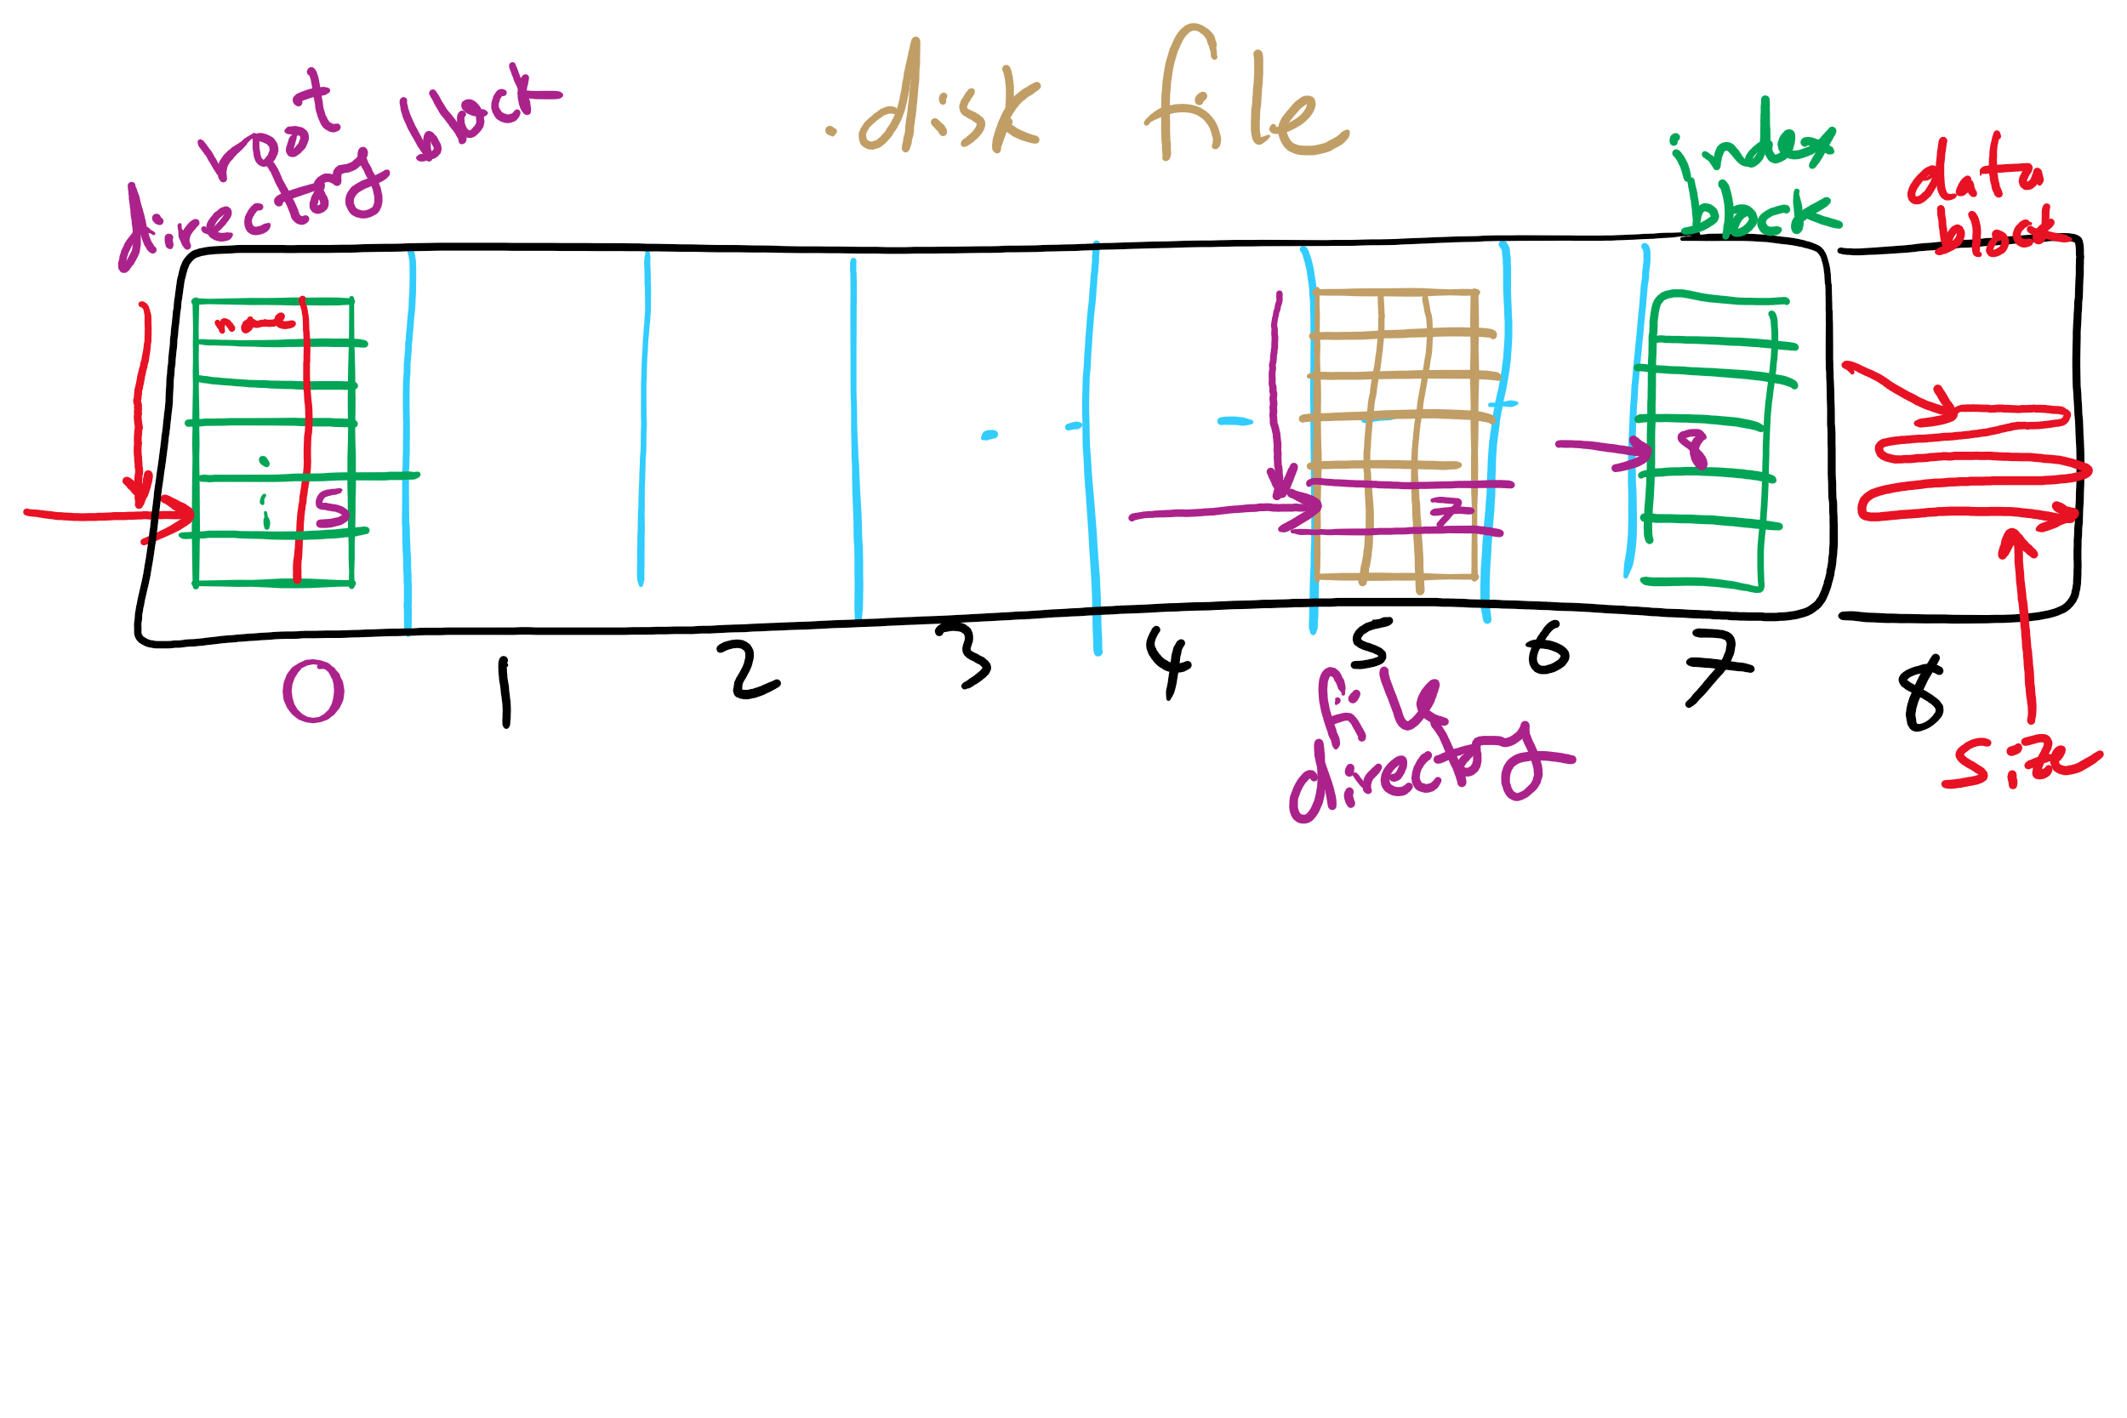
Project 4: Directory Traversal

Slide 45
Protection
Protection is about controlling access of programs, processes, or users to the system resources (e.g., memory pages, files, devices, CPUs)
How to decide who can access what?
Specifications must be
Correct
Efficient
Easy to use (or nobody will use them!)

Slide 46
Protection domains
A process operates within a protection domain
resources accessible by the process
each domain lists objects with permitted operations
Domains can share objects & permissions
Objects can have different permissions in different domains
There need be no overlap between object permissions in different domains
How can this arrangement be specified more formally?
File1 [R] File2 [RW]
File3 [R]
File4 [RWX]
File5 [RW]
File3 [W]
Screen1 [W]
Mouse [R]
Printer [W]
Domain 1
Domain 2
Domain 3

Slide 47
Protection matrix
 | File1 | File2 | File3 | File4 | File5 | Printer1 | Camera
Domain1 | Read | Read Write
Domain2 |  |  | Read | Read Write Execute | Read Write | Write
Domain3 |  |  | Write |  |  | Write | Read
Each domain has a row in the matrix
Each object (resource) has a column in the matrix
Entry for <object, column> has the permissions
Who’s allowed to modify the protection matrix?
What changes can they make?
How is this implemented efficiently?

Slide 48
Covert channels
Circumvent security model by using more subtle ways of passing information
Can’t directly send data against system’s wishes
Send data using “side effects”
Allocating resources
Using the CPU
Locking a file
Making small changes in legal data exchange
Very difficult to plug leaks in covert channels!

Slide 49
Covert channel using file locking
Exchange information using file locking
Assume n+1 files accessible to both A and B
A sends information by
Locking files 0..n-1 according to an n-bit quantity to be conveyed to B
Locking file n to indicate that information is available
B gets information by
Reading the lock state of files 0..n+1
Unlocking file n to show that the information was received
May not even need access to the files (on some systems) to detect lock status!

Slide 50
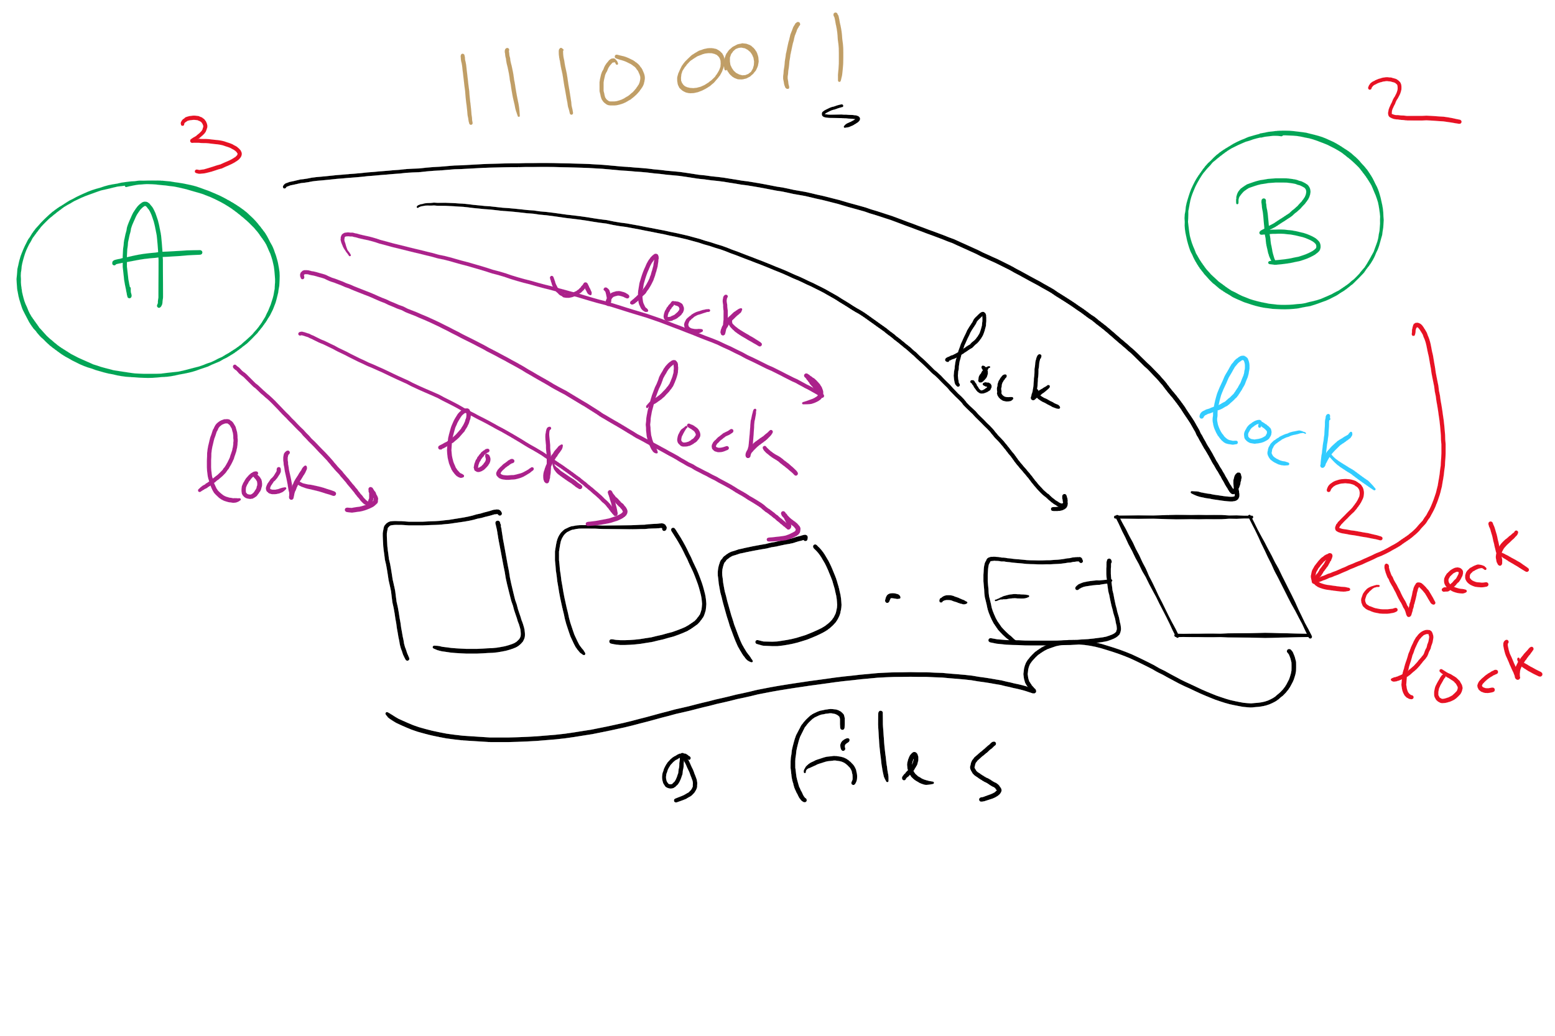
Covert Channel Using File Locking

